Slide 1
PUBERTY & HYGIENE REVIEW
Name of Presenter
Date

Slide 2
PUBERTY AND HYGIENE REVIEW
This information was developed by the Comprehensive Health Promotion Public Health Nurses for teachers to use to assist in teaching Puberty and Hygiene.

Slide 3

GROUND RULES
ALL questions are good questions
It’s ok to giggle or be embarrassed
Use correct terms
Respect others’ points of view
No personal questions
Discussions are confidential. With 2 exceptions: disclosure of suicidal thoughts OR disclosure of abuse by a caregiver.
Notes:
Review ground rules.

Slide 4

ICE BREAKER
Notes:
Ask the students to introduce themselves and list their favourite… (choose from the list below):
Movie
TV series
Snack
Meal
Restaurant
Song
Colour
Or choose your own ice breaker.

Slide 5

LET’S REVIEW PUBERTY
Totally normal
Happens to everyone
Notes:
Puberty is the time when the body develops and changes from a child to an adult. It is a series of physical, mental, emotional, and sexual changes that take you from childhood into adulthood.
Puberty usually starts between age 10 and 13 and lasts two to four years. For females and males usually starts between age 9 and 14 and lasts up to 4 years may begin puberty between the ages of 10 and 17. It is important to remember everyone develops at their own pace. (Kids Help Phone, 2023). The changes that you experience in puberty happen to different people at different times. Girls usually experience puberty earlier than boys. Puberty takes several years to complete; there may be times when you grow fast and times when your growth slows down. Puberty begins when the pituitary gland releases hormones that stimulate the testicles and the ovaries to produce their own hormones. The ovaries produce estrogen and progesterone, and the testicles produce testosterone.
Additional Information
Optional video:
www.youtube.com/watch?v=Bw1N06PKhu4 - Always changing and growing up-co-ed puberty education beginning to about 7 minutes 25 seconds

Slide 6
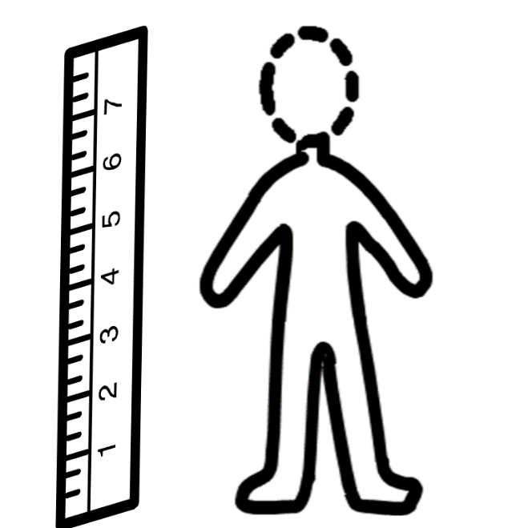

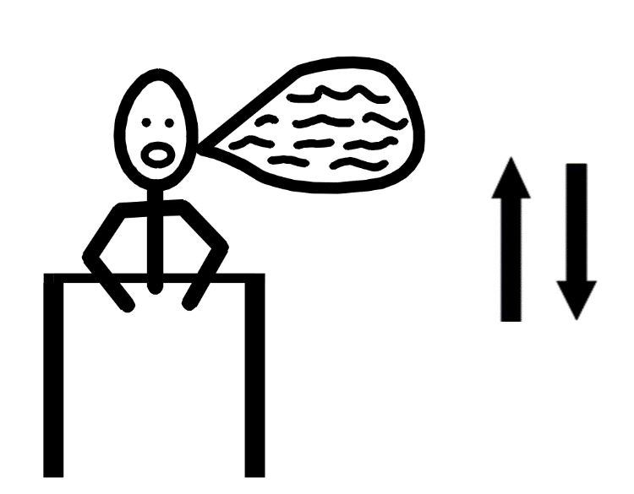
PUBERTY CHANGES
Notes:
Puberty Changes:
There are lots of changes that occur in the body. Physical changes can include:
Grow taller
Oily skin, oily hair
Voice changes. Vocal cords increase in size, causing the voice to deepen in males.

Slide 7
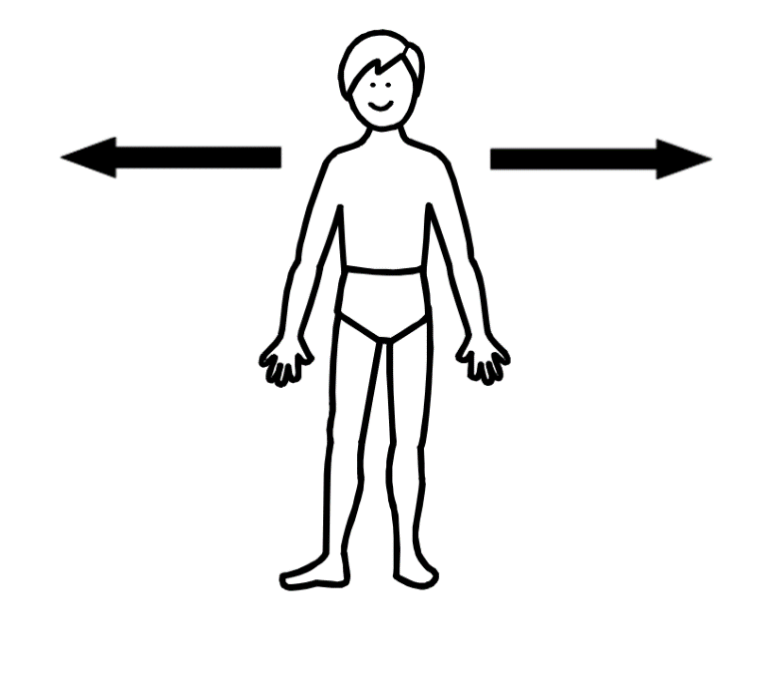
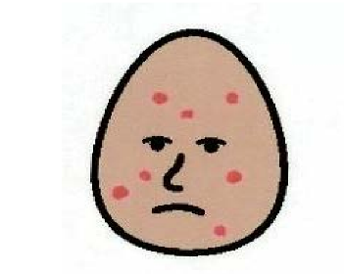
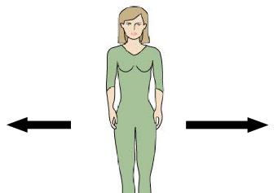
PUBERTY CHANGES
Notes:
Physical Puberty Changes:
Acne (pimples)
Shoulders get wider- males.
Body becomes more muscular.
Hips get bigger- girls.

Slide 8
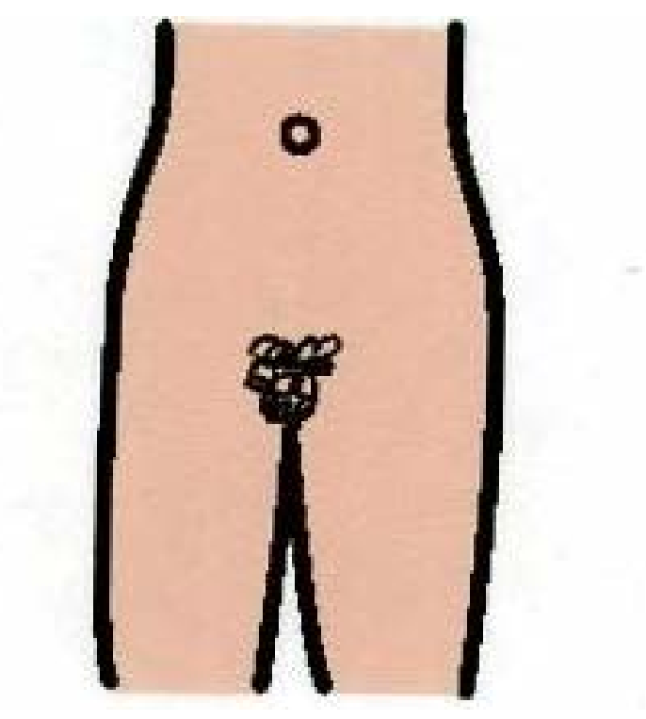
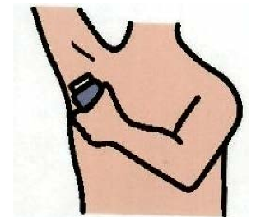
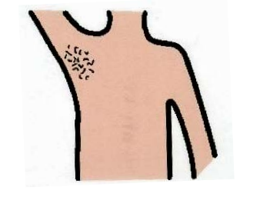
PUBERTY CHANGES
Notes:
Physical Puberty Changes:
Sweating
Sweat glands develop
2 types of sweat glands-apocrine and exocrine-over 2.5 million sweat glands in total.
Sweating is very important as it helps your body regulate its temperature.
As you get older, your sweat can start to smell unpleasant when it comes in contact with germs on the skin. This smell is known as B.O. (body odour).
Hair Growth
Hair grows in the genitals (pubic hair)
Hair grows in the underarm
Facial hair

Slide 9

PUBERTY CHANGES-MENTAL/EMOTIONAL
Notes:
Emotional/Social changes that occur during puberty include:
Start having sexual thoughts/feelings
Can become interested in having a partner
Friendship becomes more important
Mood swings
Sometimes feel lonely and confused
Stronger feelings of wanting to be liked or “fit” in
Want more independence- going out with your friends more
More responsibility
Thinking about your future- jobs
Concerned about your looks- start working out, dye your hair

Slide 10
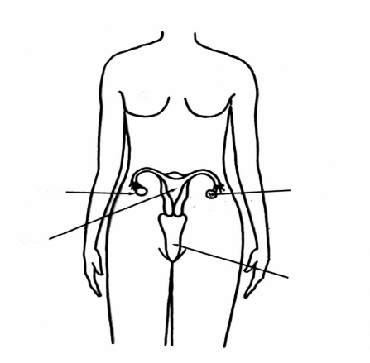
FEMALE REPRODUCTIVE PARTS
Notes:
Let’s talk about the physical changes that occur in females. (Explain that we cannot see our internal organs so we have to imagine that we can see them in our bodies).
Breasts-are on a person’s chest. Breasts grow through puberty and may get bigger as you age. A bra is worn to support the breasts. You should ask someone you trust to help go shopping for a bra.
The whole area of soft skin between the female legs is called the vulva.
The labia are two sets of soft folds of skin inside the vulva. Labia majora and labia minora.
Vagina – connects to the uterus where menstrual blood, vaginal intercourse, and childbirth occurs. Not used for urination.
Cervix- is at the bottom of the uterus that opens into the vagina.
Uterus – the place where a baby grows during pregnancy, feeds and protects baby. Also called the womb.
Clitoris- part of female’s genitals which is full of nerves.
Fallopian Tubes- narrow tubes that connect the ovaries to the uterus, fertilization occurs here.
Ovaries– are two small organs (the size of your thumb nail) where the egg is made.
Ova – the egg that can make a baby when fertilized with the sperm. Ovum are released once a month after puberty begins. Occasionally 2 or more ovum are released.
Urethra- the tube through which urine passes the body, part of the urinary system.
Bladder- sac that holds the urine produced by the kidney, part of the urinary system.
Anus-the opening at the end of the digestive tract where feces or stool leaves the body. Part of the digestive tract.

Slide 11
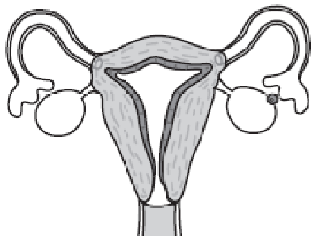
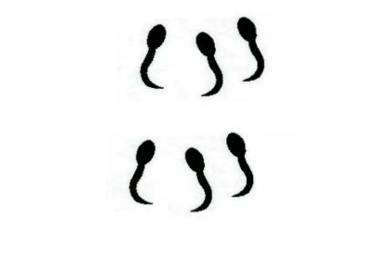
PUBERTY CHANGES
Notes:
FEMALES
Start releasing eggs (ovulation)
Periods (menstruation)
Start producing a vaginal discharge- you may notice a white or clear liquid that comes out of the vagina and appears on your underwear, this normal and helps keep the vagina clean. You may want to wear a panty liner. If the discharge changes in smell, colour, or becomes clumpy like cottage cheese, this is not normal, and you should follow up with your doctor.

Slide 12
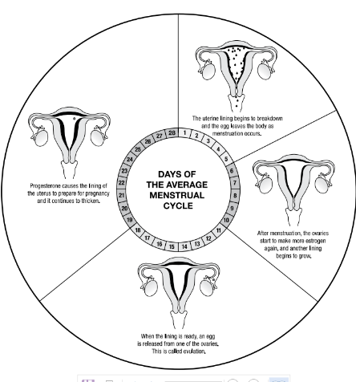
MENSTRUATION
Notes:
Begin by asking what students know about ‘periods’
Once a month, girls who have reached puberty have a period. Another name for having a period is menstruation/menarche. There are also slang words e.g., having your monthly, rag.
Menstruation can begin as early as 8 or as late as 16. Every body is different.
The lining of the uterus builds up every month to prepare the body to nourish a baby during pregnancy. If a baby is not conceived, 4–6 tablespoons of blood is shed through the vagina as it is not needed. This is a normal part of life.
Menstruation can last 3-7 days every month.
Menstrual cycles generally occur every 28 days but may take place as often as 20 days or every 35 days. The length of time between each menstrual period differs for everyone. Especially those who have just started their periods, they may have an irregular number of days between periods.
Menopause means that the person is no longer producing eggs (ovulating) and therefore can no longer become pregnant. Menopause is a time when a female permanently stops menstruating. This is a gradual process that happens anytime between the ages of 42-56. The average age of menopause is 52.
Additional Information:
You may choose to review the diagram with the class:
Days 1-5: Fertilization has not occurred, there is a sloughing off of the uterine lining. This menstrual flow consists of blood, mucous, and other tissues. This is your period.
Days 6-13: One ovum begins to develop inside a sac or follicle in an ovary. The lining of the uterus grows thicker in preparation for a fertilized ovum. The follicle with the ripe ovum will move towards the surface of the ovary.
Day 14: The ripe ovum breaks away from the follicle and ovary. The process is called ovulation. It will enter the fallopian tube where fertilization can take place. If fertilization does not occur, the ovum will disintegrate in 24 to 48 hours.
Day 15-28: If there is no fertilization, the lining of the uterus is not needed and starts to break down. Around the 28th day, it will leave the uterus as menstrual flow and a new menstrual cycle will begin.

Slide 13
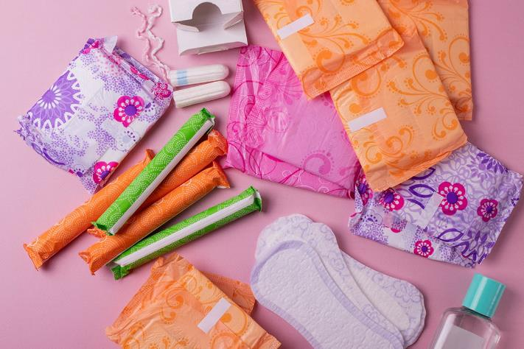
PERIOD PRODUCTS & HYGIENE
Notes:
Use Pre-Teen Hygiene Kit (from WECHU) for demonstration
Pads and period underwear are used to soak up the menstrual flow. Tampons and menstrual cups catch the flow from inside your vagina. Pads, period underwear, tampons, and menstrual cups can be used at different times. Some can also be used together. Pads and tampons come in different sizes depending on how heavy your flow is. Products should be changed every 4 hrs; this will keep odour under control.
What do I do with used menstrual product?
Trash it don’t flush it.
Fold it up.
Wrap it in toilet paper.
Put it in the garbage. (Small bin in the bathroom stall if there)
PMS and Period Cramps. What causes them? What can I do about them?
Cramps can occur just before or during your period when the muscle of your uterus contracts to make the lining of your uterus leave your vagina as menstrual flow. Moderate exercise, warmth to the belly, pain meds.
Will anyone notice when I have my period? Will they be able to smell it?
Not unless you tell them! Menstrual fluid can start to smell when it comes into contact with the air. However, you can help to minimize this by changing your pad or tampon regularly and by washing yourself regularly too.
Can I participate in physical activity and normal everyday activities?
Yes! Menstruation is a normal part of life so you can do normal things. 800 million people menstruate every single day!
Being active can:
Reduce cramping and other symptoms. Some exercises include stretching, Yoga and aerobic activity.
Release endorphins (happy hormones)
Improve your mood
Help you handle stress
Important to be prepared-have a period purse-small pouch such as a pencil case or makeup bag for the “just in case it happens and I’m not home”. If not, talk to trusted adult, teacher, guidance office. Products are available for students.
Additional Information
Studies have indicated that more than one-third of people believe that one should restrict physical activity while menstruating. This belief can be traced back to historical attitudes towards menstruation. Young people may unconsciously adopt these beliefs and feel uncomfortable participating in physical activity while they have their period. A person with female sex organs often wish to keep secret or hide the fact they are menstruating. They may feel it will be difficult to hide menstruation while changing clothes or showering.

Slide 14
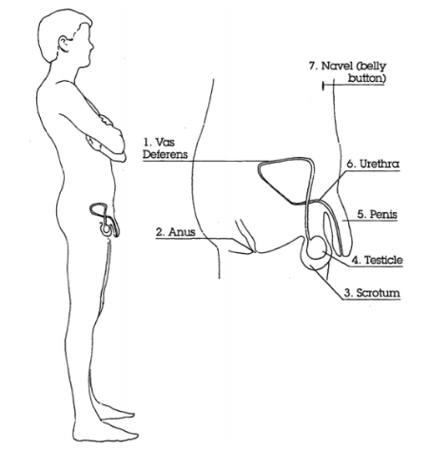
MALE REPRODUCTIVE PARTS & PUBERTY CHANGES
Notes:
Puberty Changes:
Penis grows larger, testicles get bigger
Start producing sperm
Wet dreams-a male might wake up and notice a thick white liquid in his underwear
Sperm released through the penis (ejaculation)
Erections happen out of the blue
Penis- made of spongy material that fills up with extra blood (becomes erect when sexually aroused), semen and urine come from the penis.
Scrotum- a sac that holds the testicles, which have to be kept at a certain temperature just below body temperature to produce healthy sperm. The scrotum will pull the testicles closer to the body if it is cold and lower away from the body if it is hot.
Anus- the opening at the end of the digestive tract where feces leaves the body, part of the digestive tract.
Testicles- held in the scrotum, male sex glands. They are outside of the body so that they can stay cooler than body temperature for healthy sperm production. It is normal for one to hang lower. Sensitive area, it is important to protect the testicles during contact sports.
Vas Deferens- narrow tube that carries sperm from the testicles to the urethra.
Seminal Vesicles- two small pouches behind the bladder that produce and store seminal fluid, which mixes with sperm and other fluid to produce sperm.
Urethra- urine and semen pass through this tube to the outside of the body. Urine and semen cannot come out at the same time. There are two branches to the urethra, one from the bladder and one from the vas deferens. When the penis is ready to release semen, a valve blocks off the branch to the bladder so urine cannot escape.
Bladder- sac that holds the urine produced by the kidney, part of the urinary system.
Sperm- male reproductive cell, millions are made every day in the testicles.
What is Spermatogenesis?
The process in which males produce functional sperm. During puberty, the testicles start to produce sperm with the production of testosterone. Testosterone is the hormone that causes males to develop physical, emotional and social changes that occur with puberty. The testicles produce about 400 million new sperm every day. When sperm mature, they travel through the vas deferens, combining with other fluid from the prostate, Cowper’s gland and seminal vesicles to make seminal fluid, which is called semen. When the penis is ready to ejaculate, a valve blocks off the branch to the bladder so no urine can escape. Semen travels through the urethra and is released from the penis. An ejaculation contains 150-500 million sperm. During puberty, males may sometimes ejaculate when they are asleep, which is known as a nocturnal emission or “wet dream”. Involuntary erections are also common during puberty and may happen for no apparent reason. The penis becomes hard or erect because of the rush of blood that fills the penis. A penis can become erect in reaction to cold, the urge to urinate, during sleep cycles, or from sexually arousing thoughts or touch. These occurrences are a normal part of puberty and there is nothing to be ashamed of.
Circumcision: is the removal of the foreskin covering the head of the penis, usually done during infancy. It is done for religious, cultural or hygienic reasons.
Self-Care: Penis and testicles should be washed and carefully dried daily. If uncircumcised, pull the foreskin back to wash away smegma. Drying carefully is important to avoid chapping. Chapping can be uncomfortable and is sometimes called jock itch. It can be treated by applying corn starch or over the counter meds.
Erections: Explain that usually the penis is soft and hangs down, but a penis can also get big and hard. This is called an erection. There are slang words for erections that you may hear e.g., a “boner” (although the penis does not actually contain a bone). Point out that erections are normal and a part of growing up. They happen for many reasons or for no reason at all. It can happen when you least expect or want it. It can be embarrassing when it happens.
Thoughts and feelings about sex can make an erection happen. Stress that erections are private. It is important to know what to do when a young man has an erection. Ask your students if they have any ideas of what a young man should do if he has an erection in a public place. If your students are unable to come up with ideas, provide them with some suggestions: If a young man has an erection when he is around other people, he should try to go to a washroom to readjust his penis in private. Wash hands. If he cannot go to a washroom, he should sit down. Erections are not as noticeable when seated. He can put a book or a coat over his lap. He can sometimes control his erections by what he thinks about. Thinking of something boring can help erections go away faster.
Wet Dreams: Further explain that if a young man has a wet dream, he should wipe himself off with a tissue or damp wash cloth. Then he should change his pyjamas or underwear and put the dirty ones into the wash. Wet dreams and having an ejaculation are private.

Slide 15
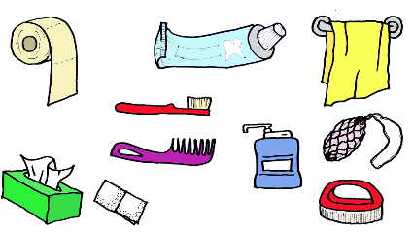
PUBERTY CHANGES & HYGIENE
Time to talk about why hygiene is important!
Notes:
Use Pre-Teen Hygiene Kit (from WECHU)
Use antiperspirants - this help to stop B.O. from developing by reducing underarm wetness by temporarily blocking sweat pores, thereby reducing the amount of sweat reaching the skin and mixing with bacteria, a main cause of underarm B.O.
Deodorant and antiperspirant come in different types - solids, roll-on, aerosol and soft solids.
Daily body care
Shower or bathe with a gentle soap and warm water. Wash your hair every day or every other day, clean your nails. This will eliminate the germs that can lead to odor.
Change clothes after bathing and heavy physical activity.
If you get really sweaty, you will need to shower more than once a day.
Additional Information
Depending on the class, you may want to include a cultural competency statement such as: “in Canada we use the term B.O. which stands for body odour. Not all cultures use that term or see natural body odours as offensive.”

Slide 16
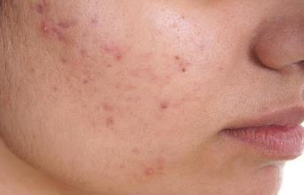
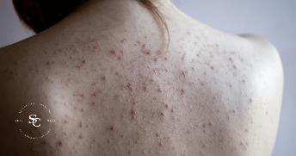
ACNE-WHAT IS IT?
Acne is normal during puberty and sometimes throughout adulthood.
Some parts of your life can contribute to acne.
Everyone’s bodies are different and may have different skin care needs.
Notes:
Skin care
Acne is normal during puberty and sometimes into adulthood.
Everyone’s bodies are different and may have different skin care needs.
Pimples are caused by oil glands in your skin that become plugged.
Causes include genetics, hormones, oil, and bacteria. Things that can make acne worse…..
clothing such as bra straps, chin straps, hats
pore-clogging cosmetics/not properly removing make-up daily
sweating
over washing/exfoliating the skin
certain medications
changes in hormones due to menstrual cycle
picking or squeezing acne spots
sun
Stress
Tips
It is important to wash your face every day in the morning and at night with a gentle soap/cleanser.
Use sunscreen to protect your skin.
Use oil free make-up products.
Don’t squeeze or pop pimples (can spread bacteria, cause scarring).
Don’t scrub your face too much as it can lead to irritation and aggravate acne.
Change and wash your pillowcase and sheets regularly.

Slide 17
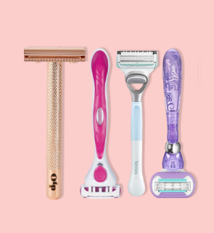

BODY HAIR
Body hair will increase on different parts of the body such as the legs, underarms, chest, upper lip, or chin.
Removing body hair is a personal choice
There are many ways of removing body hair
Talk to a parent/guardian or trusted adult to learn more about your options and safe hair removal practices
Notes:
During puberty, some may notice an increase in hair on different parts of the body such as the legs, under the arms, upper lip, or chin. Choosing to remove body hair is an individual choice. Some may choose to shave this hair and may not need to shave very often at first.
*Myth: Shaving does not cause hair to grow back thicker or faster (Mayo Expert Answers).
Additional Information
How to shave:
Prepare the skin: rinse the area to be shaved with warm water to open the pores.
Apply a thin layer of shaving cream or gel to help reduce skin irritation.
Shave the easy areas first. Start with light/gentle strokes in the direction the hair grows to avoid irritation, razor burn.
Rinse the skin and pat dry, then apply a moisturizer to seal in the skin’s natural moisture barrier.
Do not share razors and change your razor regularly.
Healthy hair
Dull and limp hair is caused by dirt, dust, pollution, and perspiration. Hair can be damaged by heat (from curling irons and hair dryers), brush rollers, over-teasing, dyes and bleaches, brushes with sharp bristles, and styles that tug at the roots.
Styling products can be used but have different functions: gels hold shapes and styles, mousses give a softer hold and sometimes extra volume, hair spray holds style (too much will make hair sticky or hard looking), and waxes may hold styles as well.
Shampoos and conditioners should be used for all hair types: normal, dry, fine, coarse, and oily. Wash as frequently as required and rinse thoroughly. Shampoo will help remove dirt, oil, and hair products. Conditioners will help detangle and add moisture to hair and help protect it from damage. If hair looks greasy or dirty between washings, it may need to be washed more frequently. Swimming may cause damage to hair because of chemicals in the water. Use shampoo and conditioner immediately after. If hair is cut very short, sunscreen may be needed to protect the scalp and neck from burning when outside.

Slide 18

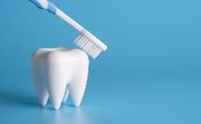
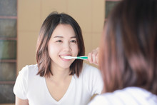
DENTAL CARE
Notes:
Dental Care
Good care of the mouth is important in the prevention of cavities and halitosis, also known as bad breath. Persistent bad breath can be a sign of gum disease, dry mouth, or poorly maintained oral care. Things that can be done to keep the mouth healthy and fresh:
Brush with toothpaste for 2 minutes at least twice a day, first thing in the morning and before bed.
Always use a soft bristle brush and toothpaste containing fluoride. Brush teeth on all surfaces. Finish with the tongue, the roof of the mouth (palate), and floss between all the teeth.
When snacking and you do not have access to a toothbrush, rinse the mouth with water whenever possible.
Visit the dentist regularly for a cleaning and check-up (minimum yearly).
Change toothbrush every 3 months or when able to replace it.
Additional Information
*The WECHU has dental programs that might support a student who does not have dental coverage: Healthy Smiles.-https://www.wechu.org/dental/healthy-smiles-ontario

Slide 19
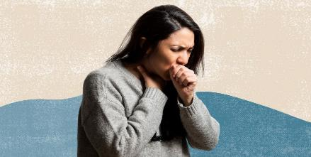

HANDWASHING AND COUGHING
Notes:
What are some ways to help stay healthy?
Eating healthy, regular exercise, proper coughing and sneezing etiquette, not sharing food or drinks with others, regular check-ups with your health care provider, getting the flu shot and immunizations, staying home when you don’t feel well, resting and sleeping, staying away from others who are sick, take all medication as prescribed, and proper hand washing and hygiene.
Use a spray bottle, or the spray bottle from the borrowed Pre-teen hygiene kit and spray water while mimicking coughing or sneezing to demonstrate how far droplets can travel and spread, then proceed to discuss proper coughing, sneezing, and hand hygiene etiquette.
These are the best methods to prevent the spread of germs:
Cough into your sleeve.
Use a tissue and dispose of it in a garbage container then wash your hands.
Wash your hands after sneezing or coughing.
Wash your hands after using the bathroom and before eating.
Use hand sanitizer if no soap or water is available.
To help prevent a urinary infection for persons with a vagina, remember to wipe from front to back with toilet paper after using the bathroom.
Stay home if you’re sick!

Slide 20

KAHOOT
https://create.kahoot.it/login
Notes:
Login: csh@wechu.org
Password: !October37
Click on Quiz- Puberty and Hygiene Review
Click on three dots, then preview
Classic, enter game pin
Enter nickname
Play

Slide 21

QUESTIONS

Slide 22
REFERENCES
Canadian Guidelines for Sexual Health Promotion with Disabled Youth, Sex Information & Education Council of Canada (SIECCAN) https://www.sieccan.org/
Differing Abilities, Teaching Sexual Health https://teachingsexualhealth.ca/teachers/grade/differing-abilities/
https://www.mayoclinic.org/healthy-lifestyle/adult-health/expert-answers/hair-removal/faq-20058427#:~:text=No%20%E2%80%94%20shaving%20hair%20doesn't,perhaps%20appear%20darker%20or%20thicker.
https://phecanada.ca/teaching-tools/always-changing
https://www.wechu.org/dental/healthy-smiles-ontario
www.youtube.com/watch?v=Bw1N06PKhu4
Notes:
Additional resources:
Kids Help Phone, 2023: https://kidshelpphone.ca/?s=puberty&s_page=support
-Provides information on many topics related to puberty.
2. Always Changing Grades 5-6 (PHE Canada): https://phecanada.ca/teaching-tools/always-changing-grades-5-6
-This free set of instructional materials will help students understand these changes, and that they are a natural part of their development. The program includes a Leader Guide, Student Guide, Parent/Guardian Guide, and Worksheets to help students identify the connection between personal choice and healthy body systems, including body care and body knowledge.

