Slide 1
Personal Boundaries and Consent
Name of Presenter
Date

Slide 2
PERSONAL BOUNDARIES & CONSENT
This information was developed by the Comprehensive Health Promotion Public Health Nurses for teachers to use to assist in teaching Personal Boundaries and Consent.

Slide 3

GROUND RULES
ALL questions are good questions
It’s ok to giggle or be embarrassed
Use correct terms
Respect others’ points of view
No personal questions
Discussions are confidential. With 2 exceptions: disclosure of suicidal thoughts OR disclosure of abuse by a caregiver.
Notes:
Review ground rules.

Slide 4

ICE BREAKER
Notes:
Ask the students to introduce themselves and list their favourite… (choose from the list below):
Movie
TV series
Snack
Meal
Restaurant
Song
Colour
Or choose your own ice breaker.

Slide 5
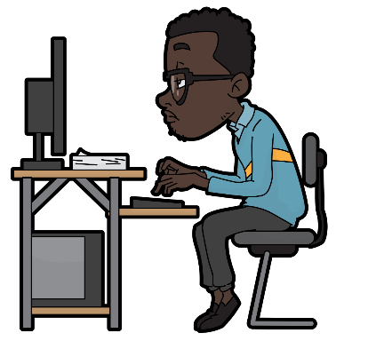
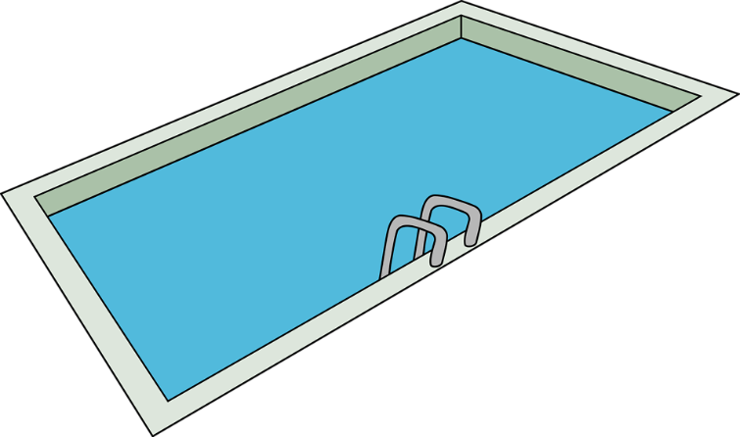
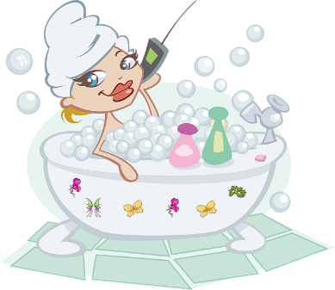

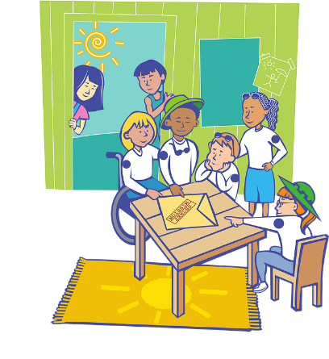

PUBLIC VERSUS PRIVATE PLACES
Notes:
*The slide will be blank while describing the information*
Explain public place:
a place where there is more than 1 person
places where you are likely to see other people
Skating arena, library
Ask the students what are public behaviour/activities:
things you can do when you are with or around other people
Dancing, eating, reading, preparing food
Explain private place:
is a place where there is only one person
Is a place in which you are usually alone
Ask the students what are private behaviour/activities:
things you do when you are by yourself, and they should occur in an appropriate private place
Brushing teeth, picking nose, adjusting underwear, going to the bathroom
Click and ask the students if these places are considered public or private?
Public: classroom, kitchen, school yard, park, shopping mall, swimming pool, online chat room, restaurant
Private: bathroom, bedroom

Slide 6


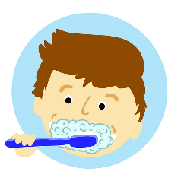
PUBLIC VERSUS PRIVATE ACTIVITIES
PUBLIC ACTIVITIES | PRIVATE ACTIVITIES
Eating lunch | Putting on make-up
Riding the bus | Brushing your hair
Singing | Getting dressed/undressed
Dancing | Putting on deodorant
Watching TV | Kissing
Playing a game | Touching your private parts
Cooking | Talking about sexual feelings
Washing dishes | Shaving
Notes:
Click and ask the students to identify if the activity is public or private? (washing dishes, dancing, brushing your teeth)
Click and the chart will appear- Review chart to cover more public vs private activities.
Once complete, ask the students if “talking on the phone” would fall under a public or private activity?
It could fall under both depending on the conversation, what Is being discussed.

Slide 7
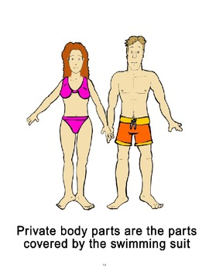
APPROPRIATE AND INAPPROPRIATE TOUCH
Appropriate Touch
Hugs/ cuddles with someone close to you
Holding hands with someone close to you
High five
Receiving help with hygiene when needed
Visit to health care professional
Inappropriate Touch
Hitting/kicking/pushing
Pinching/slapping
Unwanted touch that starts as fun
Being forced to touch someone
Touching of private body areas that is not for hygiene/examination by HCP
Notes:
Taking care of your body includes saying who can touch you and come into your personal space. Everybody deserves to be treated with respect. Your body is private, and some parts are more private than others.
Private Body Parts: These are body parts that are covered by a bathing suit or underwear/bra
Private parts should be covered when you are in public places
If you want to touch or scratch your private parts you should wait until you are in a private place
No one can touch your body without your permission
No one can see your body without your permission
Your body should not be shown to anyone who does not want to see it
Ask students to describe what appropriate touching means to them. Once answers are provided- click- a chart will appear- review the chart
Explain that appropriate touches are respectful, kind and caring. They are “thumbs up” touches.
Ask students to describe what an inappropriate touch means to them. Once answers are provided- click- a chart will appear- review the chart
Inappropriate touches are disrespectful, confusing, scary, and or hurtful. They are “thumbs down” touches.
Ask the students what they can do when someone inappropriately touches them?
Explain that there are 3 safety rules that they can follow:
Say no: Have the students say “NO” aloud and explain how to be assertive.
Get away: walk or run away or get out of the situation. Go to a safe place like your home, neighbour’s house, school.
Tell someone you trust: ask students to think of all the people who they could tell like a parent, teacher, grandparent.
Ask: Who is the owner of your body?
You own your body. Your body is unique and special, and everybody is different.
Ask: What can you do with your body?
Run, jump, dance, clap, laugh, eat.
Ask: How do you take care of your body?
Eat healthy foods, exercise, personal hygiene.

Slide 8

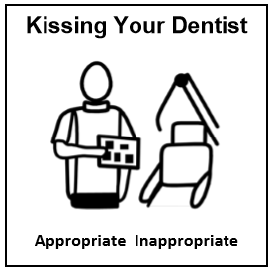
ACTIVITY
Notes:
Activity: Appropriate/Inappropriate Touch Pictures:
Click and the picture will appear and ask the class if these are appropriate or inappropriate to describe touch. Students can use thumbs up (appropriate) thumbs down (inappropriate)

Slide 9
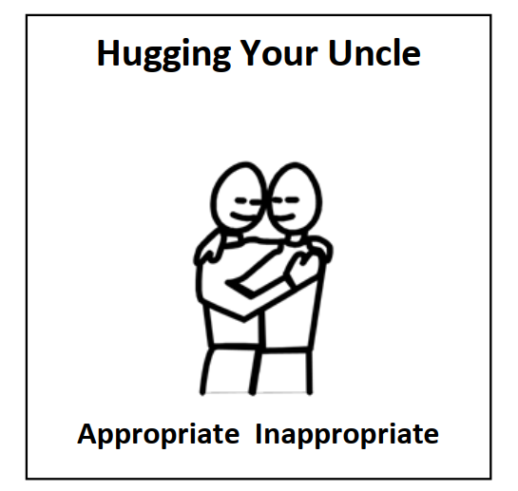
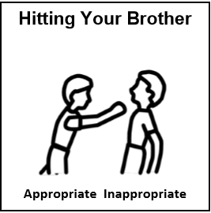
ACTIVITY
Notes:
Activity: Appropriate/Inappropriate Touch Pictures:
Click and the picture will appear and ask the class if these are appropriate or inappropriate to describe touch. Students can use thumbs up (appropriate) thumbs down (inappropriate)
** Elaborate on hugging your uncle as some may view this as appropriate/inappropriate. Explain that the student may like their family member, but if the touch makes them feel uncomfortable- they do not have to accept or give a hug, they are the boss of their body**

Slide 10
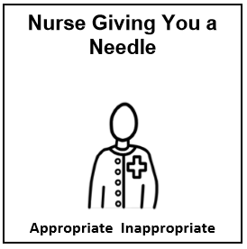
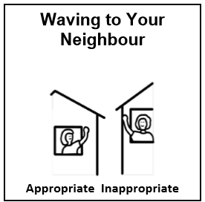
ACTIVITY
Notes:
Activity: Appropriate/Inappropriate Touch Pictures:
Click and the picture will appear and ask the class if these are appropriate or inappropriate to describe touch. Students can use thumbs up (appropriate) thumbs down (inappropriate)

Slide 11
PERSONAL SPACE
You
People closest to you
Close friends and relatives
Other friends and acquaintances
Community helpers and neighbours
Notes:
Personal space:
The inner most circle includes only one person and that is you. You are the most important person in your world. This is your private space and no one can touch you unless you want to be touched. Discuss with the students the factors they would consider before letting a person in their private space:
Who would you let in your private space? Ex. Parents, siblings, doctors
Where can they touch you?
What kind of touch would you accept? Depends on the person
When can they touch you?
Why can they touch you?
The second circle that surrounds you are people that are closest to you are usually family members and close friends. People who belong in this circle share a close, loving relationship with you. These people may include your immediate family members like your mom, dad, brothers/sisters. Appropriate touches may include kisses, cuddles, and hugs.
The third circle that surrounds you are people like your close friends and relatives. Appropriate touches may include a one-arm hug, or even a pat on the back or shoulder. These actions are less intimate and include less physical contact then the previous circle.
The fourth circle includes other friends/acquaintances whose names are known to you. These are people who have been introduced to you, but you do not know them well. Appropriate touch includes handshakes.
The fifth circle includes people who you occasionally see around your neighbourhood. These are people who have very little in common with you. Community helpers may include: store clerks, postal workers, restaurant waiters. Appropriate touch includes a simple wave or a nod to people with a familiar face.
The last circle includes people that you do not know. You do not know their name and do not recognize their face. You have nothing in common with these people. Touching does not happen with these people. These people are often known as strangers.
Ask the students: Is a stranger a good or bad person?
Many of the students will think that strangers are bad. Remind them that they cannot tell whether a stranger is good or bad by looking at them. A stranger is a person they do not know and thus, cannot tell whether they are good or bad. Reinforce that they need to be cautious of strangers because they cannot tell if they are good or bad, rather than “all strangers are bad”.
Ask the students: How would you know a person is a stranger?
May never have seen the stranger before, may never see the stranger again, and they do not know anything personal about the stranger.
Ask the students: Where they see strangers?
Public places
Brainstorm with the students: What would they do if:
a stranger offers to drive them home
a stranger falls near them
a stranger asks them to go to the movies
a stranger asks for the time
a stranger asks for money

Slide 12

CONSENT
https://www.youtube.com/watch?v=h3nhM9UlJjc
Notes:
Play video and then review the following information.
What does it mean to give consent?
To give permission
To say “yes” or “no”
To be allowed to do something.
Understanding consent means that a person has the skills to leave a situation that doesn’t feel comfortable, and respects when other people want to do the same.
What does consent sound like?
“Yes”
“Sure”
“Yes please”
“I’ll allow that”
“Of course!”
“Okay!”
*Must sound positive and enthusiastic*
When do we need to ask for consent?
Giving hugs
Borrowing things
Secrets
Touching another person
Kissing
Sharing
Any kind of sexual activity
What to say if you do not want to give consent?
“I don’t feel like it right now”
“Maybe another time”
“I don’t want that”
“No thank you”
“I need to use the bathroom”
“I'm not ready”
“I really like you but I am not comfortable with that. I am okay with ____. Is that something you would like to do?”
Additional Information
Consent to Sexual Activity
The age of consent is the age at which a young person can legally agree to sexual activity. Age of consent laws apply to all forms of sexual activity, ranging from kissing and fondling to sexual intercourse.
All sexual activity without consent is a criminal offence, regardless of age.
These are serious offences that carry serious penalties, including mandatory minimum penalties. The age of consent to sexual activity is 16 years. In some cases, the age of consent is higher (for example, when there is a relationship of trust, authority or dependency).
In other words, a person must be at least 16 years old to be able to legally agree to sexual activity.
Close In Age Exceptions: A 14- or 15-year-old can consent to sexual activity as long as the partner is less than five years older and there is no relationship of trust, authority or dependency or any other exploitation of the young person. This means that if the partner is 5 years or older than the 14- or 15-year-old, any sexual activity is a criminal offence.
There is also a "close in age" exception for 12- and 13-year-olds. A 12- or 13-year-old can consent to sexual activity with a partner as long as the partner is less than two years older and there is no relationship of trust, authority or dependency or any other exploitation of the young person. This means that if the partner is 2 years or older than the 12- or 13-year-old, any sexual activity is a criminal offence. https://www.justice.gc.ca/eng/rp-pr/other-autre/clp/faq.html
Sexual exploitation
A 16- or 17-year-old cannot consent to sexual activity if:
their sexual partner is in position of trust or authority towards them, for example their teacher or coach
the young person is dependent on their sexual partner, for example for care or support
the relationship between the young person and their sexual partner is exploitative
The following factors may be taken into account when determining whether a relationship is exploitative of the young person:
the young person's age
the age difference between the young person and their partner
how the relationship developed (for example, quickly, secretly, or over the internet)
whether the partner may have controlled or influenced the young person

Slide 13
GIVING CONSENT…WHAT IF
You really want a hug, but the other person doesn’t?
NOT Consent
Notes:
Review scenario, discuss with the students. Click and answer will appear.

Slide 14
GIVING CONSENT…WHAT IF
The other person says “NO” but they are smiling?
NOT Consent
Notes:
Review scenario, discuss with the students. Click and answer will appear.

Slide 15
GIVING CONSENT…WHAT IF
You are in the middle of a hug and the other person changes their mind?
NOT Consent
Notes:
Review scenario, discuss with the students. Click and answer will appear.

Slide 16
GIVING CONSENT…WHAT IF
You ask someone you like if you can kiss them and they say “Yes!” enthusiastically?
Consent is given
Notes:
Review scenario, discuss with the students. Click and answer will appear.

Slide 17

Questions

Slide 18
References
Canadian Guidelines for Sexual Health Promotion with Disabled Youth, Sex Information & Education Council of Canada (SIECCAN) https://www.sieccan.org/
Differing Abilities, Teaching Sexual Health https://teachingsexualhealth.ca/teachers/grade/differing-abilities/
https://www.youtube.com/watch?v=h3nhM9UlJjc

