Slide 1







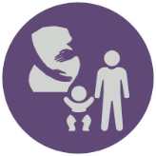


SUBSTANCE USE SPOTLIGHT:
OVER THE COUNTER AND PRESCRIPTION MEDICATION
Name of Presenter
Date

Slide 2
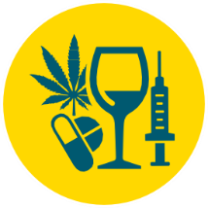
Group Expectations
It’s okay to ask questions or not know the answer
Respect others when they are speaking
No put-downs
Do not share what others speak about
Take a break if you need one
Notes:
Read ground rules
Explain that everyone has different experiences with substance, and everyone may have different feelings towards this information. It is absolutely okay not to agree with everything, but we are going to remain respectful.
When reading “do not share what others speak about,” explain that you will not share the personal experiences of student except for the disclosure of suicidal thoughts or abuse by a caregiver.
Explain that it is okay to take a break if you need one – the presentation will cover some heavy topics, so bathroom or water breaks are okay.

Slide 3
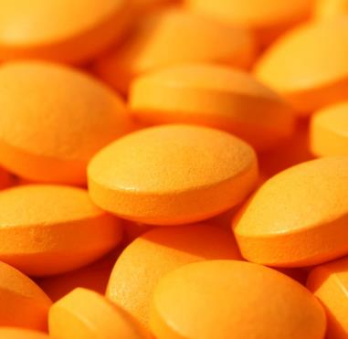


What is Substance Use?
Substance use means using alcohol, tobacco, nicotine, cannabis, prescription drugs, or other substances that can change the way you think, feel, or act.
Over-the-Counter Medication
Examples: Advil, Tylenol
Prescription Medication
Examples: Opioids, Benzodiazepines
Illegal Substances
Examples: Prescription medication (e.g. opioids) without a prescription
Notes:
*Start with a blank title slide
Ask the students what they think substance use is. After they answer, click to reveal the definition in the orange circle.
Explain that in this presentation, you will be talking about medication, and there are a lot of different medications out there.
Click through and read each example.

Slide 4
What is Substance Use?
Sometimes, substances can be helpful
Taking medication as prescribed by your doctor
Other times, substances can be harmful
Drinking and driving
Taking someone else’s medication, or taking medication not as prescribed
Using illegal drugs (e.g. heroin, cocaine)
Some people may develop a substance use disorder
When we can’t stop using substances, even when we want to or we know they are hurting us
Poisoning or overdose
Following the directions on the medication bottle
Notes:
Explain that substances can be a normal part of our lives, even if we don’t know it.
Ask students when substances might be helpful. Wait for responses, then click to reveal the answers:
Taking medication as prescribed
Following instructions on the medication bottle
Ask students when substances can be harmful. Wait for responses, then click to reveal answers:
Drinking and driving
Taking someone else’s medication, not taking your medication as prescribed
Using illegal drugs (e.g. heroin, cocaine)
Poisoning or overdose (taking more than our bodies can handle)
Explain substance use disorder (also known as addiction):
When we can’t stop using substances even when we want to or when we know it is hurting us
Explain that a substance use disorder is a medical condition that affects the brain and the body, makes it very hard to quit.

Slide 5

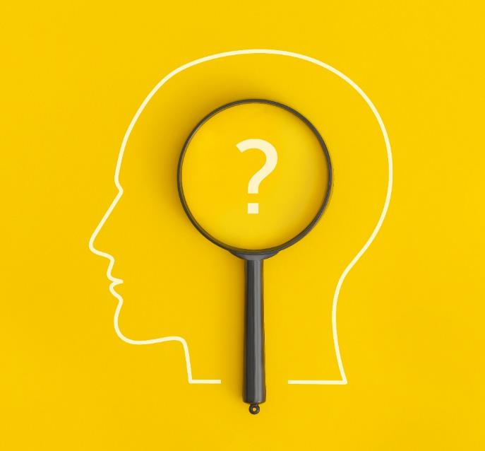


Why Do Youth Use Substances?
Stress
Curiosity
Peer Pressure
Enjoy the Feeling
Notes:
*Start with title slide
Ask students why youth use substances (e.g. why youth drink, vape, use cannabis, or use prescription medication when they are not supposed to)
Wait for responses, then reveal answers by clicking through each circle

Slide 6

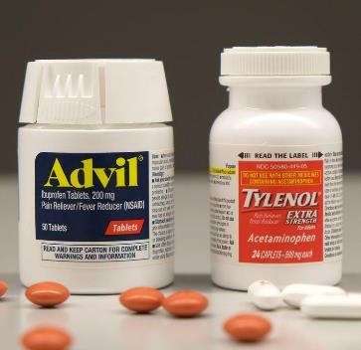
Non-Medical Use of Medications
What substance is the leading cause of poison control centre calls in Canada?
Pain medication
(acetaminophen, ibuprofen, opioids)
Notes:
This slide introduces non-medical use of medication. Start by asking students what substance they think causes the most poisonings in Canada.
Wait for responses, then reveal answer – pain medication.
Speaking notes:
Year after year, medication is the leading cause of poison control centre cases in Canada – specifically pain medication. More than alcohol, cannabis, cleaning supplies, or other drugs. In 2024, there were 34,000 calls to poison control centres across Canada related to exposure to pain medication. This happens when people take medication that wasn’t prescribed to them, or when they don’t follow the instructions from their doctor/pharmacist or the medication bottle.
Pain medication includes acetaminophen and ibuprofen (which you probably know as Advil and Tylenol), and they also include opioids, which we will talk about in a little bit.
Other medication that can be harmful if not taken as prescribed include anti-depressants, sleeping medication, allergy medication, or stimulants like ADHD medication.
What does this mean? This means that common household items like Advil or prescription meds can cause a lot of harm if they are not used properly. Just because a substance comes from a doctor or a drug store doesn’t automatically mean it is safe.

Slide 7
Overview of Youth Medication Use
In 2023, 22% of Ontario teens used a prescription opioid to get high
10% of Ontario teens report using cough and cold medication to get high
Both these numbers are much higher than they were four years ago
The most common source of prescription drugs is the home
Most teens (66%) don’t ask for help because they think they can manage it themselves
There are misconceptions about opioids and other substances
Notes:
To read with blank slide: Generally, youth substance use in Canada has decreased over time. When we look at substances like alcohol and cigarettes, there are a lot less youth who are smoking and drinking compared to 10 or 20 years ago. But, we still have some work to do. Some substances are being used at higher rates than in the past.
Reveal first bubble: In 2023, 22% of Ontario teens in grades 7-12 used a prescription opioid (powerful pain medication) for non-medical use (to get high). This tells us that kids are starting to use substances at a pretty young age, which is why it is so important to have these conversations early.
Reveal second bubble: Along with prescription drugs, 10% of students report using over-the-counter cough and cold medication to get high (over-the-counter medicine that anyone could buy at the pharmacy).
Reveal third bubble: Both of these numbers are much higher compared to several years ago. The rates of prescription and non-prescription medication use almost doubled within the last few years.
Before revealing fourth bubble: Ask students: Where do we think youth are getting access to these medications?
Reveal fourth bubble: 67% of youth report getting opioids from their home - not on the street, not from school, they just go in the medicine cabinet in their own house.
Explain that, as discussed earlier, there are a lot of reasons why youth might use drugs – e.g. to cope with stress, peer pressure, etc.
Ask students: What do we do when we are struggling with stress or peer pressure? (*ask the group)
You might say we ask for help from a trusted adult, a professional, etc. But some people don’t reach out for help even when they are struggling.
Reveal fifth bubble: Among Ontario teens, one of the most common reasons for not asking for help with their mental health is because they think they can manage it themselves. Now when youth are using alcohol, cannabis, nicotine, or someone else’s prescription medication to manage their mental health, this will most likely worsen mental and physical health. We’ll talk about other coping strategies later on.
Reveal sixth bubble: There is a lot of misinformation out their about different substances like opioids, so naturally, some people have misconceptions about them. Some people might think that if they come from a doctor, they must be safe, so it’s better or less risky than illicit drugs or alcohol, etc. While it’s true that some substances carry more risk than others, any substance has the ability to cause harm depending on how we use them.

Slide 8
What is an Opioid?
Examples: Percocet, Tylenol 3, Fentanyl
Help with pain
Can cause euphoria (high)
Highly addictive
Slows breathing
Can cause overdose
Notes:
As mentioned previously, youth are using prescription opioids for non-medical use at much higher rates today than they used to. So, it’s important that we understand what opioids are and what their effects are.
Ask students before revealing answers – what is an opioid?
Wait for responses, then reveal first point: Opioids relieve pain. Some examples of opioids include Percocet (which has oxycodone) and Tylenol 3 (which has codeine), which are often prescribed after surgeries or dental procedures. Other examples include fentanyl, a really strong opioid which you may have heard about in the news.
Reveal second point: Opioids help with pain by slowing down the pain signals to your brain. They make your brain release endorphins, which try to make you feel good when you are in pain or stressed.
Reveal third point: These endorphins that make us feel really good can create a sense of euphoria, which is a fancy way of saying they can make us feel high (a temporary feeling of relaxation, well-being, or happiness).
Reveal fourth point: This “high” only lasts for a very short amount of time. Because of this, opioids are very addictive.
Reveal fifth point: As mentioned before, opioids slow down the pain signals to the brain. They do this by affecting the central nervous system. The central nervous system also controls our breathing, so when we take a large amount of opioids, we could also slow down our breathing.
Reveal sixth point: When we take more opioids than our body can handle, we risk overdosing. If this happens, our breathing could become dangerously slow, and we could actually stop breathing.

Slide 9
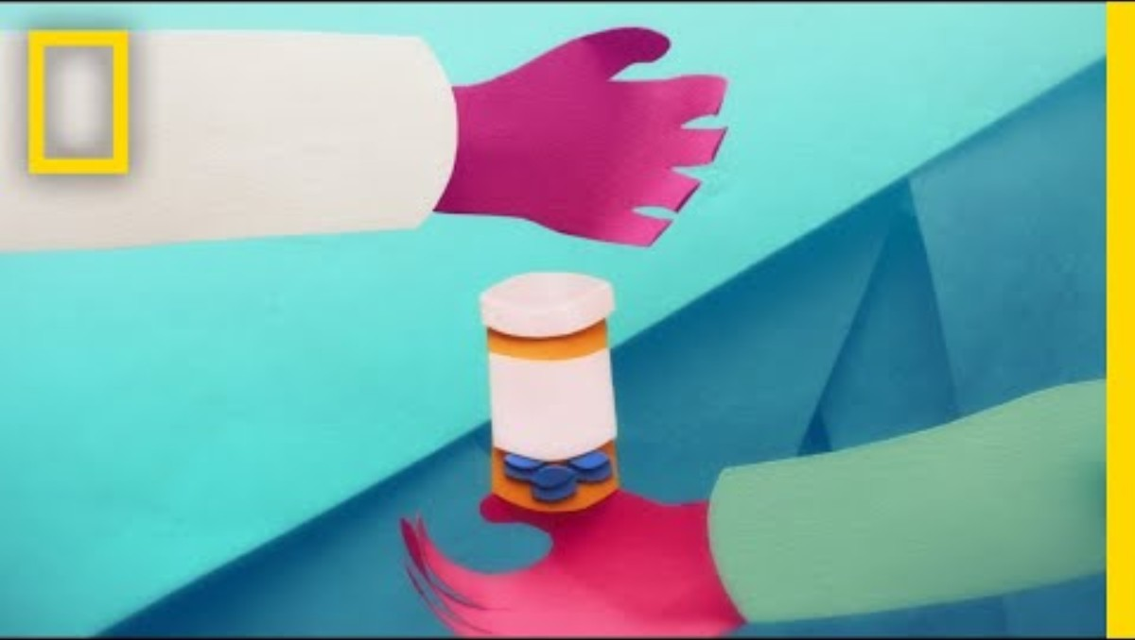
How Opioids Work
Notes:
*link for video - https://www.youtube.com/watch?v=NDVV_M__CSI
Speaking notes:
Now we have a video that shows how opioids affect the body and the brain.
But, before I play this video, I just want to make something clear. The goal of presenting this information is not to make everyone scared of opioids or think that everyone who takes opioids is going to become addicted.
Opioids can be beneficial, and most people who take them don’t become dependent on them. There are a lot of factors that can influence addiction – our environmental, our past experiences, our genetics, our mental health, and so many other things.
The goal of this information is to make sure that you can make educated choices about what is best for you, and so that you have the knowledge to use medication in a way that is going to help you instead of hurt you.

Slide 10
About Sedatives
What do we know about sedatives?
Often used to for anxiety or sleep
Other examples of prescription medication used to get high include stimulants and sedatives
Examples include Xanax or Ativan
Slow down brain activity
What are the risks of taking sedatives when we aren’t supposed to?
Short term effects: drowsiness, decreased heart rate and blood pressure, slower breathing, slurred speech, dizziness, disorientation, confusion or memory loss, slowed reaction time
Long term effects: vision problems, sleep problems, liver problems
Can cause tolerance and addiction
Dangerous to mix with other substances, especially other substances that slow our breathing (e.g. opioids)
Are sometimes mixed with opioids in the unregulated drug supply
Notes:
Speaking notes: Opioids are the most common type of prescription medication that youth are using for non-medical use, but other types of medication are also being used at higher rates such as stimulants and sedatives.
Ask students - What do we know about sedatives?
Wait for responses, then reveal answers:
Sedatives are often prescribed for anxiety, seizures, or sleep, or they may be used to sedate someone before a medical procedure.
Sedatives work by slowing down brain activity (similar to the effects of opioids).
Examples include benzodiazepines or barbiturates. Examples of medication you may have heard of include Xanax or Ativan.
Some sedatives like benzodiazepines, medetomidine, or xylazine can show up in the unregulated drug supply (i.e. illegal drugs) that are mixed with opioids. This is why illicit drugs carry a lot of risk – they can include dangerous combinations and it is usually very hard or impossible to know what is in a substance when it doesn’t come from a reputable source like a doctor or pharmacy.
Click to reveal orange bubble: what are the risks of taking sedatives when we aren’t supposed to?
Click to reveal answers:
Short term effects can include: drowsiness, decreased heart rate and blood pressure, and slower breathing. This is because sedatives decrease our central nervous system functioning, which controls things like breathing. We could also experience dizziness, disorientation, memory problems like confusion or a loss of memory, and slowed reaction time. Slower reaction time means that we are much more likely to get into a car accident.
Long term, they can cause vision problems, sleep problems, or liver problems. They can also lead some people to build up a tolerance, which means you get used to the amount you take and need to keep taking more to feel the same effect. And, they can cause a sense of euphoria or high, so they can become addictive and lead to a substance use disorder.
Because sedatives slow down our central nervous system, it can be very dangerous to mix them with other substances that slow down our central nervous system, like opioids or alcohol. This is because our breathing and heart rate could decrease more rapidly and increase our risk of overdose.

Slide 11
About Stimulants
What are the risks of using stimulants when we aren’t supposed to?
Increased heart rate and blood pressure, nausea and vomiting, insomnia, decreased appetite, dizziness, anxiety, paranoia
What do we know about stimulants?
Speed up brain activity
Makes us feel more awake, alert, and energized
Can be prescribed to people with ADHD or narcolepsy (a sleep disorder)
Dangerous to mix with other substances
Sometimes used non-medically by athletes or students
Examples include amphetamines and methylphenidate (brand names include Adderall, Vyvanse, or Concerta)
Low risk of addiction when used as prescribed, but can lead to addiction when used not as prescribed
Illegal stimulants include cocaine, crystal meth or MDMA (ecstasy or molly)
Can overdose – seizures, heart failure, high fever
Notes:
Ask students – what do we know about stimulants?
Wait for responses, then reveal answers:
Stimulants speed up (or stimulate) brain activity. They make us feel more awake, alert, and energized.
Often prescribed to people with ADHD or narcolepsy (a sleep disorder).
Examples of prescription stimulants include amphetamines and methylphenidate (brand names you may have heard of include Adderall, Vyvanse, or Concerta)
Examples of illegal stimulants (which have no medical use) include cocaine, crystal meth (methamphetamine), or methylenedioxymethamphetamine (MDMA) commonly known as ecstasy or molly.
Other legal stimulants include nicotine (for ages 19+) (found in cigarettes and vapes), and caffeine (found in coffee and energy drinks)
Ask students – can anyone guess what happens when we take stimulants when we aren’t supposed to, or when we take too much?
Wait for responses, then reveal answers:
Stimulants speed things up in our body, so they are going to make our heart beat faster and our blood pressure increase. They can cause dizziness, decreased appetite, nausea and vomiting, and can make it very difficult to fall asleep. They can also change our mood by making us more anxious or paranoid. This is especially true when the effects of stimulants start to wear off.
If we take very high doses, just like other substances, we can overdose. We risk seizures, heart attacks or other cardiovascular issues, and a very high fever – this is because stimulants increase our heart rate and central nervous system to dangerously high levels when we take too much and can have long-term effects.
When we take them as prescribed, there is very little risk of addiction. They can be very helpful, for example, for people with ADHD who are prescribed stimulants from a doctor by improving attention span and controlling impulsive behaviour. However, when we take them not as prescribed, or when we take illegal stimulants which are very strong, they can lead to addiction.
*ask students – why might someone want to take stimulants when they don’t have a prescription?
Some reasons why people might use stimulants for non-medical use include athletes or students who need energy for performing or studying.
Ironically, the vast majority of those who use stimulants to study or improve their academic performance generally get lower grades compared to those who do not use stimulants for non-medical purposes
Stimulants are very dangerous to mix with other substances. When you take them with something like an opioid or sedative, those substances have the opposite effect on the body (one speeds up the body, one slows it down). This doesn’t mean that they cancel each other out, it means that effects can be unpredictable. Sometimes, one substance will mask the effect of the other, so you may not feel like much is happening. Sometimes this makes people want to take more, which drastically increases your risk of overdose.
This is why it is so important to talk to your doctor or pharmacist about the medication you are taking and if you are also taking any over-the-counter medication to make sure that you don’t experience any negative effects.

Slide 12
Knowledge Check
Taking someone else’s prescription opioid is illegal, even if they share it with me
True False
Notes:
Ask students: is taking someone else’s prescription opioids illegal?
Wait for responses, then reveal answer:
The answer is yes, it is illegal to take someone else’s prescription.
Medications like opioids are controlled substances in Canada, which means they are illegal without a prescription. Other controlled substances include sedatives and stimulants like the ones we just talked about. So, even if you have someone’s permission, it is still illegal to take someone else’s medication.

Slide 13
Why We Shouldn’t Take Someone Else’s Medication
Everyone’s needs are different
because we are all different!
Notes:
Ask students: why should we not take someone else’s prescription medication?
Wait for responses, then reveal content.
Speaking notes:
Everyone is different, and that is why your medication and the dosage is chosen specifically for you by your doctor. Your age, height and weight, overall health, other medications you may be taking, allergies, all play a role in deciding what medication, and how much, is right for you. When you take someone else’s medication, you are taking medication that is right for THEM (maybe not you). Just because it is medicine or it was given by a doctor, doesn’t mean it is safe for you.
Maybe the medication meant for someone else is way too much for your body to handle. In this case, you could get really sick or risk overdosing when you take someone else’s medication – or, if you take more than you are supposed to of your own medication.
It can be very dangerous mixing medications with other substances – whether that is other medication, alcohol, marijuana, etc. If you take medication that isn’t prescribed to you, it might react with other things you are taking and you might not even know it.
Usually, doctors provide just enough medication for a specific time frame. If you take someone else’s medication, they might not have enough for themselves.
And, when we take medication for non-medical use (or to get high), we are more likely to become dependent on that substance (or develop a substance use disorder) – especially when we are young and our brains are not finished developing.

Slide 14
Tips for Safer Substance Use
Only take medication that is prescribed to you
Follow the instructions from your doctor or pharmacist
When you are done with your medication, take it to the pharmacy
Notes:
To make sure that you stay safe when taking medication, here are some steps you can follow:
Reveal first point: Only take medication that is prescribed to you. Do not take other people’s medication, even if they say it is okay. Other peoples’ medication are meant for their body, not yours.
Reveal second point: Follow the instructions of your doctor or pharmacist. Take the right dosage at the right time of day, and follow any other instructions (e.g. how long to stay on your medication). Do not take more than prescribed. If you feel like your medication isn’t working, talk to your doctor or another professional.
- This also applies to over-the-counter medication (like cough medication or Advil). Make sure you read and follow the instructions on the label so that you are using the medication properly and don’t take too much.
Reveal third point: If you don’t need your medication anymore and you have some left over, or if you have expired medication, bring it to the pharmacy so they can get rid of it. Don’t throw it in the garbage or flush it down the toilet. This is because we don’t want substances contaminating the environment (our land or water), and we don’t want animals or other people to stumble upon them. Getting rid of your expired or unused medication is a good way to make sure everyone in your household stays safe.

Slide 15
Tips for Safer Substance Use
Do not take other substances you might have in your household like alcohol or cannabis
Keep medication locked up and out of sight and reach from children
Learn how to use Naloxone and know how to call for help in an emergency
Notes:
Reveal first point:
You might have access to other substances in your house, like alcohol, cannabis (gummies, vapes, etc.), or cigarettes. There is a reason you have to be 19 to drink and smoke – those substances can affect the development of your brain.
Anyone know how old you are before your brain is fully developed? (ask students, then say the answer) – 25! That means when you take substances like cannabis, alcohol, or nicotine when you are young, it could affect the parts of your brain responsible for things like memory and managing your emotions. It also means it is way more likely that your body can’t handle those substances yet, and they could make you very sick.
Reveal second point:
It’s important to keep medication and any substances (like alcohol, cannabis gummies or vapes) locked up, out of sight, and out of reach. This prevents small children from accidentally taking medication, and it keeps everyone in your household safe from unintentionally or intentionally ingesting a substance. This is even important for common household items like Advil or Tylenol which, as we saw earlier, are common sources of poisoning in Canada. This also applies to things like vitamins or supplements.
Reveal third point:
If you or someone else is having a medical emergency because of medication they took, call 911. If you have questions about medication safety or you worry that you may have taken something that you shouldn’t, you can call Ontario Poison Control to ask for advice. It is also a good idea to learn how to use Naloxone
Ask students: has anyone ever heard of Naloxone before?
Naloxone is a medication that can reverse an overdose when someone has taken too many opioids. This might be because they accidentally took too much of their prescription, or maybe they took something from someone else without realizing how strong it was. You can get Naloxone from most pharmacies and also from some organizations in the community.

Slide 16
What is Substance Use Stigma?
Negative beliefs and stereotypes, judging someone
Makes people feel ashamed, less likely to ask for help
Offensive language, name-calling, labels (e.g. “addict” or “druggie”)
Leads to discrimination, prejudice, social isolation
Notes:
Speaking notes:
We started to learn about some ways to increase medication safety. Sometimes, something called stigma can be a barrier to medication safety. When people feel like they will be judged for asking for help, they are less likely to ask. This means people don’t talk to their doctors, or friends and family about what they may be struggling with.
Ask students: What might stigma look like? What are some examples?
Wait for responses, then reveal first point:
Stigma is negative beliefs and stereotypes about someone because of their identity or who they are as a person. In this case, it is when we think badly or less of people because they use substances.
Reveal second point:
Stigma can come in many forms:
Judging someone
Making assumptions based on stereotypes that are often not true
Using offensive language or labeling someone (e.g. using words like addict or druggie)
There are some stigmatizing stereotypes about different medications.
For example, people who take opioids for chronic pain might be stigmatized by service providers or negative images in the media of people with substance use disorders.
Sometimes, people have negative beliefs about medication for mental health challenges, so they are afraid to ask for help or tell people they are on medication.
Reveal third point:
Stigma makes people feel ashamed and it lowers their self-esteem. This not only makes people feel bad about themselves, but if they are ashamed, they probably won’t ask for help if they need it because they are afraid of being judged by other people. This can just make the problem worse.
Reveal fourth point:
Stigma also leads to discrimination and prejudice (which means people are treated unfairly just because of who they are. They end up not having the same opportunities and getting excluded form things, whether its accidental or on purpose, and this makes people isolated) – this can show up at work, at school, in social settings, or even at the doctor when people are treated differently because they use substances.

Slide 17
How Would You Respond?
You are hanging out with your friends, and someone pulls out a bottle of pills they got from their parent’s medicine cabinet. They don’t know what it is, and they offer you one.
“No thanks, my mom would kill me if she found out.”
“I don’t want to take medication that isn’t mine, it might make me sick”
If they don’t respect your decision, you can walk away!
Notes:
Speaking notes: Now, lets take a look at some scenarios where you can practice medication safety.
Read scenario. Wait for responses, then click through each bubble.
*ask students – what are some other ways we can say no when someone offers us a substance we don’t want to take?
Examples:
“That stuff made my brother really sick one time, I don’t want to take it”
Suggest something else - “I’d rather go get something to eat instead”
“I can’t, I need to feel my best for practice later”

Slide 18
How Would You Respond?
Your friend sends you a video of a TikTok challenge where kids take as many allergy pills as they can to see if they hallucinate. Your friend says you can just buy the pills at a pharmacy or grocery store, so they can’t be that dangerous.
“No thanks, I don’t want to do that”
“That doesn’t sound safe, medication can still hurt you if you don’t use it right”
“I don’t feel comfortable doing social media challenges like that, let’s do something else instead”
Notes:
Read scenario. Wait for responses, then click through each bubble.
Speaking notes:
This was a real TikTok challenge called the Benadryl Challenge, and it reminds us that we should not do things just because they are trending on social media. Earlier this year, a teenager in Ottawa participated in this challenge by taking 36 Benadryl tablets and ended up in the intensive care unit. In 2023, a 13-year-old boy in the U.S. participated in the same challenge and died.

Slide 19
Coping Without Substances
Eat a balanced diet, get at least 8-10 hours of sleep, get regular physical activity
Listen to music, do an activity or hobby
Practice mindfulness, deep breathing, journalling
Talk to a friend or trusted adult, hang out with people who support and care about you
Notes:
Stressful situations happen all the time – some people have more to stress about than others (e.g. money, family problems, bullying, etc.) which is unfair, but regardless, it is important that we know how to cope with stressful situations in a productive and positive way so that we can stay as healthy as possible, and so we don’t have problems later on.
In 2023, 31% of teens in Ontario say that they are not able to effectively cope with unexpected problems. Now this is concerning, because when we feel unable to cope, we might turn to things that we see as solutions (like substances), that might actually end up harming us.
Ask students - What are some ways that you deal with stress?
Wait for responses, then click through answers
There are lots of ways to manage stress. There are things that can help prevent stress, like eating a balanced diet and getting enough sleep. We might not realize how important this is, but have you ever tried to deal with a problem while you were sleep deprived and also hungry? It is much harder.
There are also things that we can do to help stressful feelings go away, like deep breathing, talking to a friend, listening to music, or going outside.
What is helpful for one person may not be helpful for someone else, so find whatever makes YOU feel the best.

Slide 20
Where to Get Help
Trusted adult
Healthcare professional
Kids Help Phone
Youth Wellness Hub
Windsor Essex Community Health Centre
One Stop Talk
Notes:
Coping strategies are really important, but sometimes we might need some extra help if things get too difficult for us to handle on our own. There are a lot of resources for when we need help with our mental health or substance use.
Reveal first box: A trusted adult – could be a parent, caregiver, teacher, coach, etc.
Reveal second box: A professional – could be a doctor, therapist, pharmacist, or school nurse
Reveal third and fourth boxes: There are also several local organizations that provide services for youth including the Youth Wellness Hub and the Windsor-Essex Community Health Centre.
Reveal fifth and sixth boxes: There are online resources like Kids Help Phone and One Stop Talk, which provide virtual support (calling, texting, and web support) and also provide resources on different topics.

Slide 21
References
Abraham, O., Szela, L., Thakur, T., Brasel, K., & Brown, R. (2021). Adolescent’s perspectives on prescription opioid misuse and medication safety. The Journal of Pediatric Pharmacology and Therapeutics, 26(2), 133-143. https://pmc.ncbi.nlm.nih.gov/articles/PMC7887877/
BC Centre for Disease Control (2021). Simple habits can prevent poisoning and keep children safe at home. Retrieved from https://www.bccdc.ca/news-stories-site/Pages/Poison-Prevention-Week.aspx
Boak, A., & Hamilton, H. A. (2024a). Drug use among Ontario students, 1977–2023: Findings from the Ontario Student Drug Use and Health Survey (OSDUHS). Toronto, ON: Centre for Addiction and Mental Health. Retrieved from https://www.camh.ca/en/science-and-research/institutes-and-centres/institute-for-mental-health-policy-research/ontario-student-drug-use-and-health-survey---osduhs
Boak, A., & Hamilton, H. A. (2024b). The mental health and well-being of Ontario students, 1991–2023: Findings from the Ontario Student Drug Use and Health Survey (OSDUHS). Toronto, ON: Centre for Addiction and Mental Health. Retrieved from https://www.camh.ca/en/science-and-research/institutes-and-centres/institute-for-mental-health-policy-research/ontario-student-drug-use-and-health-survey---osduhs
Canadian Mental Health Association. (n.d.) Factors that impact addiction and problematic substance use. Retrieved from https://ontario.cmha.ca/factors-that-impact-addiction-and-substance-misuse/
Canadian Mental Health Association. (2019). Naloxone 101. Retrieved from https://cmha.ca/wp-content/uploads/2021/07/CMHA-Naloxone-Toolkit-Naloxone101-ENG-Final.pdf
Canadian Centre on Substance Abuse. (2016). Prevention of prescription stimulant misuse among youth. Retrieved from https://www.ccsa.ca/sites/default/files/2019-04/CCSA-Prescription-Stimulant-Misuse-Youth-Summary-2016-en.pdf
Canadian Centre on Substance Abuse. (2022). Sedatives. Retrieved from https://www.ccsa.ca/sites/default/files/2019-06/CCSA-Canadian-Drug-Summary-Sedatives-2019-en.pdf
Centre for Addiction and Mental Health (CAMH). (n.d.). Youth and prescription painkillers: What parents need to know. Retrieved from https://www.camh.ca/en/health-info/guides-and-publications/youth-and-prescription-painkillers#:~:text=Why%20Do%20Young%20People%20Misuse,not%20prescribed%20specifically%20for%20them
Centre for Addiction and Mental Health (CAMH). (2012a). Amphetamines. Retrieved from https://www.camh.ca/en/health-info/mental-illness-and-addiction-index/amphetamines
Centre for Addiction and Mental Health (CAMH). (2012b). Anti-anxiety medications (benzodiazepines). Retrieved from https://www.camh.ca/en/health-info/mental-illness-and-addiction-index/anti-anxiety-medications-benzodiazepines
Centeno, L. (2026). Dangerous Benadryl TikTok challenge sends Ontario teen to hospital – What parents need to know about social media trends and dares. DurhamRetion.com. Retrieved from https://www.durhamregion.com/news/most-dangerous-online-challenges/article_634c2bc0-09d5-50a4-a056-02d9f6e8644b.html?_cldee=lEYyOpMUXwKdpf5Uj_J--1Buy79RYjgl5OOMwlShoJmShK5W6JIjhZ26EgE3tzb0&recipientid=contact-8ae2227c2e8ff011b4cb6045bd5d77e0-6944d02485d948b08827428bfe2697d7&esid=e6b6cae1-1222-f111-88b3-7ced8da586b9
Cleveland Clinic. (2022). ADHD medication. Retrieved from https://my.clevelandclinic.org/health/treatments/11766-adhd-medication
Cleveland Clinic. (2023). Sedatives. Retrieved from https://my.clevelandclinic.org/health/treatments/24880-sedative
Cleveland Clinic. (2025). Opioids. Retrieved from https://my.clevelandclinic.org/health/drugs/21127-opioids

Slide 22
References
Express Scripts Canada Pharmacy. (n.d.). Dangers in sharing meds. Retrieved from https://pharmacy.express-scripts.ca/sharing-meds
Health Canada. (2022a). Prescription stimulants. Retrieved from https://www.canada.ca/en/health-canada/services/drugs-medication/prescription-stimulants.html
Health Canada. (2022b). Substance use spectrum. https://www.canada.ca/en/health-canada/services/publications/healthy-living/substance-use-spectrum-infographic.html
Health Canada. (2023). Benzodiazepines. Retrieved from https://www.canada.ca/en/health-canada/services/substance-use/controlled-illegal-drugs/benzodiazepines.html
Health Canada. (2024a). About opioids. Retrieved from https://www.canada.ca/en/health-canada/services/opioids.html
Health Canada. (2024b). About substance use. Retrieved from https://www.canada.ca/en/health-canada/services/substance-use/about-substance-use.html
Health Canada. (2025). Alcohol and drug use among students in Canada, 2023-24: Key findings from the Canadian Student Alcohol and Drug Survey. Retrieved from https://www.canada.ca/en/health-canada/services/canadian-student-tobacco-alcohol-drugs-survey/2023-2024-key-findings.html
Henry Ford Health. (2018). From toddlers to teens: Medication safety tips for parents. Retrieved from https://www.henryford.com/blog/2018/09/from-toddlers-to-teens-medication-safety-tips-for-parents
John Hopkins Medicine. (n.d.a) Medication management and safety tips. Retrieved from https://www.hopkinsmedicine.org/health/wellness-and-prevention/help-for-managing-multiple-medications
Johns Hopkins Medicine. (n.d.b). Opioids. Retrieved from https://www.hopkinsmedicine.org/health/treatment-tests-and-therapies/opioids
Mayo Clinic. (2023). Teen drug use: Help your teen avoid drugs. Retrieved from https://www.mayoclinic.org/healthy-lifestyle/tween-and-teen-health/in-depth/teen-drug-abuse/art-20045921
Mayo Clinic. (2024). How opioid use disorder occurs. Retrieved from https://www.mayoclinic.org/diseases-conditions/prescription-drug-abuse/in-depth/how-opioid-addiction-occurs/art-20360372
Mayo Clinic. (2025). Opioids. Retrieved from https://my.clevelandclinic.org/health/drugs/21127-opioids
Moore, A., L. & Brubaker, K. C. (n.d.) The top 10 misconceptions about medications. American Association for the Advancement of Science. Retrieved from Ontario Poison Centre. Retrieved from https://www.aaas.org/sites/default/files/2019-07/Top%2010%20Misconceptions%20About%20Medications_0.pdf
Nowell, M. (2024). Benzodiazepines and xylazine: effects and harms of sedatives in the unregulated drug supply. CATIE. Retrieved from https://www.catie.ca/prevention-in-focus/benzodiazepines-and-xylazine-effects-and-harms-of-sedatives-in-the-unregulated
Ontario Poison Centre. (n.d.). Poison prevention. Retrieved from https://www.ontariopoisoncentre.ca/for-families/poison-prevention/
Ontario Poison Centre. (n.d.). Current top 10 exposures – 2024 data. Retrieved from https://www.ontariopoisoncentre.ca/for-families/common-poisons/current-top-10/

Slide 23
References
Parachute. (2026). Pain medication remains the leading cause of poison centre calls in Canada. Retrieved from https://parachute.ca/en/news-release/pain-medications-remain-the-leading-cause-of-poison-centre-calls-in-canada/
Public Health Agency of Canada. (2018). Chief Public Health Officer’s report on the state of public health in Canada 2018: Preventing problematic substance use in youth. Retrieved from https://www.canada.ca/content/dam/phac-aspc/documents/corporate/publications/chief-public-health-officer-reports-state-public-health-canada/2018-preventing-problematic-substance-use-youth/2018-preventing-problematic-substance-use-youth.pdf
Sheikhan, N. Y., Henderson, J. L., Halsall, T., Daley, M., Brownell, S., Shah S., Iyer, S. N., & Hawke, L. D. (2023). Stigma as a barrier to early intervention among youth seeking mental health services in Ontario, Canada; a qualitative study. BC Health Services Research, 23(86), 1-12. https://pmc.ncbi.nlm.nih.gov/articles/PMC9877499/
Singer, D. (2025). Dopamine, serotonin, and stigma: Rethinking mental health meds. Florida Atlantic University. Retrieved from https://www.fau.edu/thrive/students/thrive-thursdays/stigma_around_psychiatric_medications/
Vermeer, J., Leatherdale, S., & Patte, K. (2025). COMPASS Windsor-Essex County Health Unit Report. University of Waterloo.
Windsor-Essex Community Opioid and Substance Strategy (WECOSS). (n.d.) Medicine cabinet clean out. Retrieved from https://wecoss.ca/resource/medicine-cabinet-clean-out
Windsor-Essex Community Opioid and Substance Strategy (WECOSS). (n.d.). Stigma impacts all of us. Retrieved from https://wecoss.ca/resource/talking-about-substance-use-why-do-words-matter
Picture References:
Kids Help Phone. (n.d.). Retrieved from https://kidshelpphone.ca/
Muskoka411. (2023). Ontario now requires Naloxone kits in at-risk workplaces. Retrieved from https://muskoka411.com/ontario-now-requires-naloxone-kits-in-at-risk-workplaces/
One Stop Talk. (n.d.) Retrieved from https://onestoptalk.ca/
Reddy, S. (2015). Advil vs. Tylenol. Which to use, and when. Retrieved from https://www.wsj.com/articles/advil-vs-tylenol-which-to-use-and-when-1431364490
Windsor Essex Community Health Centre. (n.d.). Retrieved from https://wechc.org/
Youth Wellness Hubs Ontario (n.d.). Retrieved from https://youthhubs.ca/site/windsor-essex-youth-wellness-hub

Slide 24















Windsor Office
1005 Ouellette Ave
Windsor, ON
N9A 4J8
Ph: (519) 258-2146
Leamington Office
33 Princess Street Leamington, ON
N8H 5C5
Ph: (519) 326-5716
wechu.org

