Slide 1
HEALTHY RELATIONSHIPS
Name
Date

Slide 2
HEALTHY RELATIONSHIPS
This information was developed by the Comprehensive Health Promotion Public Health Nurses for teachers to use to assist in teaching Healthy Relationships.

Slide 3

ICE BREAKER
Notes:
Ask the students to introduce themselves and list their favourite… (choose from the list below):
Movie
TV series
Snack
Meal
Restaurant
Song
Colour
Or choose an ice breaker of your preference.

Slide 4

GROUND RULES
ALL questions are good questions
It’s ok to giggle or be embarrassed
Use correct terms
Respect others’ points of view
No personal questions
Discussions are confidential. With 2 exceptions: disclosure of suicidal thoughts OR disclosure of abuse by a caregiver.

Slide 5

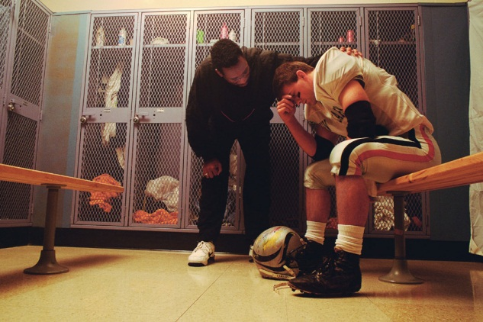


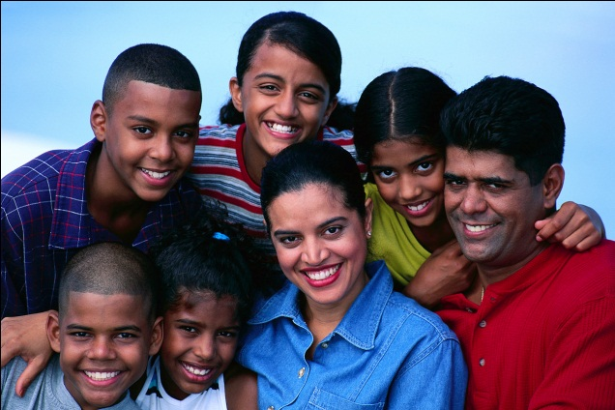
WHAT ARE RELATIONSHIPS?
Notes:
Relationships are bonds between people. Sometimes we call them connections.
Who do we have relationships with?
Parents, siblings, grandparents, aunts, uncles, cousins, friends, teammates, neighbours, coaches, teachers, caregiver/aide, work colleagues, dating partners and even pets.
From this list, which of these relationships do you get to choose for yourself (friends and dating partners). These are the relationships you have control over.
What is the most important relationship that you must form? With yourself.
Why? People who feel good about themselves make healthier decisions, solve problems better, feel happier, recover from disappointment faster.

Slide 6

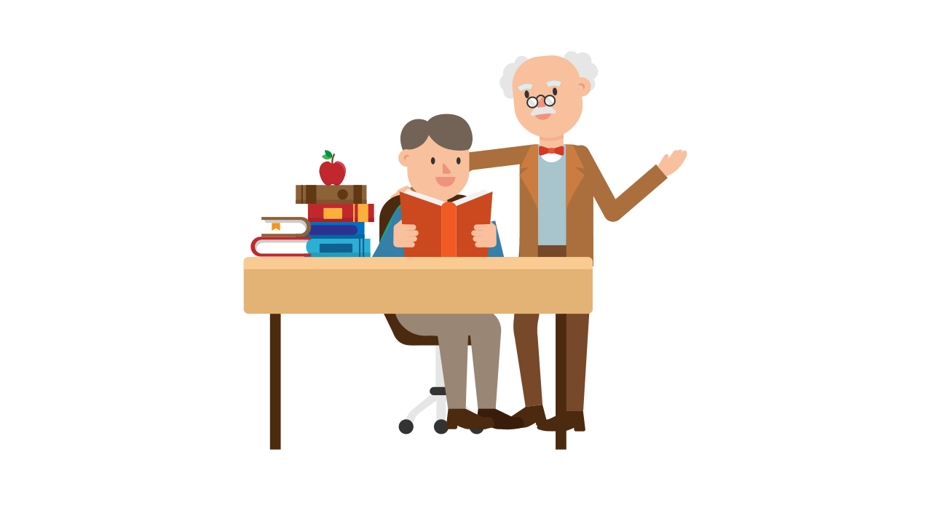
HEALTHY RELATIONSHIPS HAVE…
Safety
Trust
Acceptance
Respect
Common interests
Can be yourself
Equality
Good communication
Honesty
Fun
Notes:
Qualities that make a healthy relationship:
Safety- you feel physically and emotionally safe with each other. You are comfortable to set boundaries and say “NO”
Trust -trust is about being able to count on someone. It’s about believing that someone will be honest with you and follow through on their promises. When you trust someone, you know that they’ll support you and look out for you.
Acceptance- You feel accepted for who you are, and you accept yourself when you are in the relationship. You also accept your partner’s boundaries, decisions, values and family rules. There is no pressure between the two of you.
Respect- you feel valued in the relationship. Your decisions, values, beliefs and boundaries are respected, and you offer that in return.
Common interests- shared interests between 2 people like baking, playing board games, going to concerts.
Can be yourself-you feel comfortable around the person. Changing yourself to please someone else won’t work in the long run and can frustrate your friends and family, so it’s important to be yourself.
Equality: equality keeps relationships safe and fair. For example, being equal in a relationship means sharing the power, not bossing each other around. Equality can also mean sharing the effort. If you text or call your partner often, but they don’t seem to have time for you, your relationship may be unequal.
Good Communication-you discuss things that are important to you or your relationship. You ask each other what you’re thinking and feeling, and you listen to each other.
Honesty-you feel comfortable talking about things in the relationship, including problems or concerns.
Fun/enjoyment - you enjoy spending time together but also know how to balance other things in your life, like school/job. You also feel ok to have your own space.

Slide 7
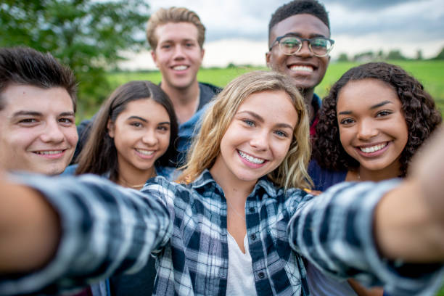
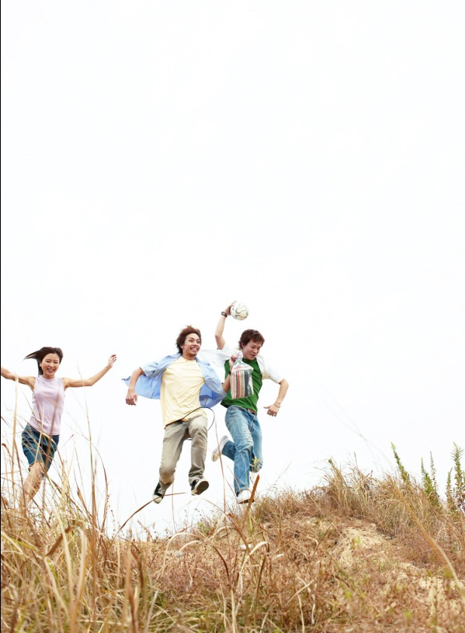
HOW DO YOU FEEL IN A HEALTHY RELATIONSHIP?
Happy
Confident
High self-esteem
Loved
Appreciated
Important
Notes:
Are you going to feel these things all the time? No, but you should MOST of the time .
The reality is that not all relationships are perfect. We want them to be but that’s not realistic. We are all human and no one is perfect.

Slide 8

UNHEALTHY RELATIONSHIPS HAVE…
No trust
No respect
Jealousy
Name calling
Lack of understanding
Poor communication
Low self-esteem
Power issues
Fighting/Arguing
Controlling
No fun
Physical, emotional or sexual abuse
Notes:
A healthy relationship make us feel happy and good about ourselves. The other person likes and respects you for who you are. Unhealthy relationships make us feel sad, stressed and give us poor self-esteem. It is important to be in a relationship because you want to be, and it feels good. As soon as a relationship starts to make you feel bad that relationship is not healthy. It’s important to recognize when things aren’t so healthy. We learn about relationships from the people closest to us. Some of us are or have been surrounded by unhealthy relationships so we grow up thinking that those unhealthy things are normal.
Unhealthy relationships have- (click to display qualities)
Why do people stay in unhealthy relationships?
People who are in unhealthy relationships often believe things will get better, the problems are just a phase or that they can change their partner. Sometimes they will have seen this type of behaviour in another relationship, for example at home and not realize that the characteristics are unhealthy. Teens may feel that having a partner is more important than getting out of an unhealthy relationship. They may be scared to break it off either because they feel they cannot cope without the other person, or the other person may be abusive or violent towards them.
If someone is in an unhealthy relationship, what can they do about it?
It is important to acknowledge unhealthy characteristics in a relationship before they become abusive characteristics. Emotional abuse such as verbal attacks may eventually turn into physical or sexual abuse. Talking to friends or adults you trust is important – often friends can provide some insight by letting you know how they see the relationship. Any type of emotional, physical, sexual abuse must be reported immediately to a trusted adult, Health Care Provider, and police.

Slide 9
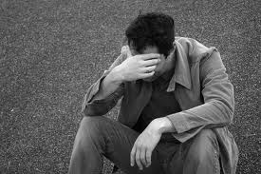
HOW DO YOU FEEL IN AN UNHEALTHY RELATIONSHIP?
Sad
Depressed
Low self-esteem
Unsure
Lonely
Nervous
Notes:
Pay attention to your feelings. Your body tells you stuff all the time. As kids we are taught to trust our gut feeling. If we are feeling scared, we run away. As teens and adults, we stop listening to the messages, begin to question ourselves. Listen to your body. If something feels wrong, it probably is!
If you notice this in a friend…tell them! Maybe they don’t see the changes.

Slide 10

DEALING WITH ARGUMENTS
Here are some tips:
Stay calm
Don’t accuse
Address the problem
Step back
Notes:
Not every relationship is healthy, sometimes arguments can take place in healthy relationships as well. Learn how to deal with arguments and continue to have a good communication with your peers, parents and loved ones.
Stay calm: try to speak calmly, no matter how upset you are.
Don’t accuse: even if you’ve been wronged, it’s better to explain how you feel than to blame or accuse the other person. For example, it’s better to say, “I felt hurt and embarrassed when you did that,” than “You think I’m an idiot.”
Address the problem: discuss what you’d like to change. Aim for a solution rather than winning the argument.
Step back: when tempers are hot, take a break. Suggest that you talk about it in a day or two, after you’ve both had time to cool off and think.

Slide 11
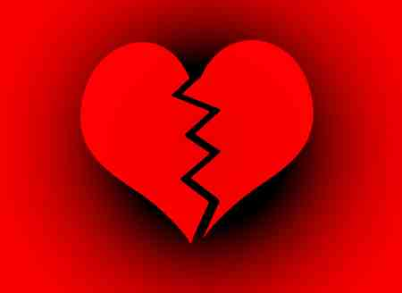
RESPECTFUL ENDINGS
Face to face
No texting, Twitter/X, Facebook, Snapchat etc.
Choose a comfortable, safe place
Most Importantly:
State feelings honestly
Stay calm
Be kind
Notes:
What would be disrespectful?
Texting, Twitter, Facebook, Vine, etc.
Sending someone else to break up.
Ignoring the person (texts etc.)
Moving on without telling them.
Why is it important to break up with someone in a respectful way?
Because they are going to tell everybody what you did.
You may have to see this person around (school) and every time you do you will remember the disrespectful ending, and this will affect your own self-respect.
LGBTQ2+ community is of smaller size than the general population it is important to end things amicably and with respect. (people talk)
Break ups provide opportunities for personal growth. In many cases people come out stronger/wiser and better equipped for the next one. Treat someone like you would like to be treated!

Slide 12

ACTIVITY
Notes:
Activity: Ask the students to give a “thumbs up” or “thumbs down” to each of the following scenarios.
You can both be honest about your feelings and talk about them freely. (Thumbs up)
You usually feel happy in this relationship. (Thumbs up)
Your partner believes that jealously is a sign of love. (Thumbs down)
Your partner is a good friend. (Thumbs up)
Your partner wants to be in control of things. (Thumbs down)
You both decide how to spend your time together. (Thumbs up)
Your partner makes all the decisions. (Thumbs Down)
Your partner is honest. (Thumbs up)
You are afraid of your partner’s temper, so you avoid making him/her angry. (Thumbs down)
Your partner has the power to make you feel bad and uses it. (Thumbs down)

Slide 13
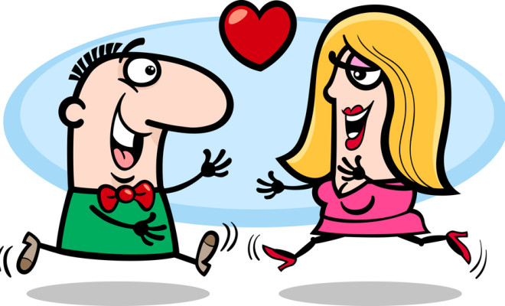
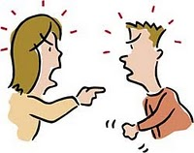
DATING RELATIONSHIPS
Notes:
Sometimes a friendship may develop into a dating relationship. How is this different from just being friends?
Having a dating partner is different because the person is more than a friend. You develop strong feelings and attraction for that person, and they are very special to you. You may feel that you want to spend all your time just with that one person. We may learn about relationships by watching family and friends, TV relationships, movies, social media, listening to the lyrics of songs, even books.
Do you need to have a partner to be in a relationship?
• Absolutely not. Some people may not be involved in an intimate relationship ever in their life –they are happy to be around family and friends.
•Sometimes someone may choose to spend time outside of an intimate relationship, particularly if they have been involved in an unhealthy relationship before.
•It is common to feel pressure to have a dating partner from friends, family or even the media.
•It is important that you always do what is right for you and do not jump into or stay in a relationship that is uncomfortable or unsafe for you.
Additional Information
Can you list activities that friends might do together (e.g., go to the movies, watch Netflix, play computer games, go for a walk, go to a hockey game, talk on the phone).
The person who becomes your dating partner may be someone who you already know as a friend but who you want to spend more and more time with. You may feel excited to be with the person and find every opportunity you can to spend time and be alone with them. Before long, you may start to feel that you are ‘more than just friends’ telling people that you have a dating partner. When you start to spend more time with someone and to date you will probably do lots of the same things as friends. Now think of some of the other things you might do only with a dating partner e.g., romantic walks, holding hands, kissing, touching, sexual activities.
What does “having a crush” mean?
It is common to have a “crush” on another person which means that you really like that person and have strong romantic feelings for that person. Sometimes your heart will race, and you may feel like you have butterflies when you see that person and you may spend time daydreaming about what it would be like to have a relationship with them. It is possible to have a celebrity crush, someone on TV or a singer that you do not know in your everyday life. Or it could be someone you know at school or in your community. Crushes sometimes do not last very long. You can have a crush, and no-one needs to know. You do not have to tell the person but if you do this may be the start of a relationship. If they tell you that they do not feel the same way back it is time to move on and accept that you will not have a relationship. You may feel sad about this, but it is a choice that the other person has the right to make. If someone tells you they have a crush on you, you do not have to have a relationship if you do not want to.
We know that dating relationships usually mean two people spending time together in a close relationship. These relationships can be complex, and usually develop over time and may consist of friendship, romantic love and/or intimacy involving sexual activity.
Before you start dating, you should talk with your family/caregiver about dating to find out if there are rules or cultural expectations that are important to them e.g., some students may know that their family has rules about how old they should be before they date or there may be a rule that dating is not allowed before marriage.

Slide 14

SEXUAL ACTIVITY
Choosing to engage in sexual activity requires responsibility and an understanding of the physical, emotional and social consequences.
Notes:
Choosing to become sexually involved requires responsibility and an understanding of social, emotional and physical consequences. Thinking about responsibilities and consequences can help. It does not mean that we think that all students are having sexual relationships, but many teens and young adults do have sexual relationships, and it is important to be prepared. Some people have sexual intercourse in their teen years, many don’t.
What is “sex”?
• Sex means different things to different people. It is usually referring to sexual activity when people do sexual things together.
What is sexual activity?
• Sexual activities can include behaviours such as kissing, sexual touching, oral sex (mouth touching penis/vagina), anal and vaginal intercourse. During intercourse, the penis is inserted into the vagina, sperm are released from the penis into the vagina. These activities are done in private. Doing these sexual behaviours in public is inappropriate and can be against the law.
What can happen when you have a sexual relationship? Adult activity=adult consequences
• Physical/health consequences – pregnancy, sexually transmitted infections (STBBIs)
• Emotional consequences – feelings ranging from happiness and love to guilt and regret
Social/relationship consequences – reputation and potentially bullying (especially via social media), family and friend’s reactions, isolation , religious/spiritual/ethical beliefs
What advice would you give someone who thinks he/she might be interested in having sex?
If you are interested in having sex, think about the physical and emotional readiness, safety and avoiding consequences just a becoming a parent or getting an STBBI. Consider religious, cultural and/or spiritual beliefs as well as moral and ethical consideration (right or wrong). Adult activity with adult consequences.

Slide 15

SEXUAL CONSENT
Sexual consent means BOTH partners agree to the sexual activity and have a clear understanding to what they are agreeing to
Consent must be given for every sexual activity, every time
Consent can be withdrawn at any time
Sex without consent is against the law
Notes:
What is consent?
Consent is permission for something to happen or an agreement to do something.
What does it mean to give consent?
To give permission
To say “yes” or “no”
To be allowed to do something.
Sexual consent means BOTH partners agree to the sexual activity and have a clear understanding to what they’re agreeing to.
Consent MUST be given for every sexual activity, every time.
Consent can be withdrawn at any time.
Sex without consent is SEXUAL ASSULT
Additional Information
Consent to Sexual Activity
The age of consent is the age at which a young person can legally agree to sexual activity. Age of consent laws apply to all forms of sexual activity, ranging from kissing and touching to sexual intercourse.
All sexual activity without consent is a criminal offence, regardless of age. These are serious offences that carry serious penalties, including mandatory minimum penalties. The age of consent to sexual activity is 16 years. In some cases, the age of consent is higher (for example, when there is a relationship of trust, authority or dependency). In other words, a person must be at least 16 years old to be able to legally agree to sexual activity.
Close In Age Exceptions: A 14- or 15-year-old can consent to sexual activity as long as the partner is less than five years older and there is no relationship of trust, authority or dependency or any other exploitation of the young person. This means that if the partner is 5 years or older than the 14- or 15-year-old, any sexual activity is a criminal offence. There is also a "close in age" exception for 12- and 13-year-olds. A 12- or 13-year-old can consent to sexual activity with a partner as long as the partner is less than two years older and there is no relationship of trust, authority or dependency or any other exploitation of the young person. This means that if the partner is 2 years or older than the 12- or 13-year-old, any sexual activity is a criminal offence. https://www.justice.gc.ca/eng/rp-pr/other-autre/clp/faq.html
Sexual exploitation
A 16- or 17-year-old cannot consent to sexual activity if:
their sexual partner is in position of trust or authority towards them, for example their teacher or coach
the young person is dependent on their sexual partner, for example for care or support
the relationship between the young person and their sexual partner is exploitative
The following factors may be taken into account when determining whether a relationship is exploitative of the young person:
the young person's age
the age difference between the young person and their partner
how the relationship developed (for example, quickly, secretly, or over the internet)
whether the partner may have controlled or influenced the young person

Slide 16
WHERE TO GET SUPPORT
Youth Services:
Trusted adult - parents, school counsellor, teacher, social worker, youth program worker
Kids Help Phone: Canada’s only 24/7 e-mental health service offering free, confidential support to young people in English and French.
Youth Wellness Hub: A one-stop-shop for youth mental health and wellness by youth for youth.
Windsor Essex Community Health Centre Teen Health: Has services for youth 12 to 24 years of age that is open Monday to Friday with set hours. Call 519-253-8481 to book an appointment and learn more about services and support systems.
For emergencies contact 911
Sexual Assault Treatment Centre, Domestic Violence and Safe Kids Program
(24 hr Windsor Regional Hospital ER Metropolitan Campus) 519-255-2234
Sexual Assault Crisis Centre (daytime) 519-253-3100 (24 hr) 519-253-9667

Slide 17

REMEMBER….
The decisions that you make in your life have consequences…..
Physical
Emotional
Social
Take care of yourself, you are important!
Notes:
The decisions that you make in your life have consequences….
Physical
Emotional
Social
Take care of yourself, you are important!

Slide 18

QUESTIONS

Slide 19
REFERENCES
Government of Ontario, Healthy Relationships, https://www.dcp.edu.gov.on.ca/en/program-planning/considerations-for-program-planning/healthy-relationships
Kids Help Phone, Healthy Relationships vs. Unhealthy Relationships, https://kidshelpphone.ca/get-info/healthy-relationships-vs-unhealthy-relationships
WR Draw the Line, https://www.dtl.whiteribbon.ca/for-educators
Nemours Children’s Health, Personal Health, https://classroom.kidshealth.org/classroom/index.jsp?Grade=68&Section=personal

