Slide 1
WEEK 4- KEEPING LIFE IN BALANCE
Notes:
Materials needed
Self-care handouts
Box to put pieces of paper in
Small papers to put in box
Pencils
Optional: Jenga game

Slide 2
INTRODUCTION
Everyone write down your first name and one advantage of art therapy.
Notes:
ASK: Last week we talked about art therapy. Who can give me an example of a type of art therapy? (Drawing or painting, playing or learning to play music, making jewelry, crafting)
Activity- (if there are prizes) Ask students to write their first name on a piece of paper, and one type of art therapy. Advise students that this is an activity to get them thinking about their mental wellness, it is not being marked or shared with the class. Put the answers in the box or bag at the front of the room.
Prizes can be anything. Examples include: a water bottle, a blank notebook, coloured pencils, markers, stickers.
Optional: if there are no prizes, just have the students write down something that causes them stress.

Slide 3
MENTAL WELLNESS SERIES
Week 1
Introduction to stress and anxiety
Week 2
Feel Good Strategy #1: Peaceful movement
Deep breathing, visualization, progressive relaxation
Week 3
Feel Good Strategy #2: Express yourself through art
Coloring, crafts, painting
Week 4
Feel Good Strategy #3: Keeping life in a balance
Self-care activities, apps for stress relief
Notes:
Week 1 objectives-
What is stress and anxiety?
What causes stress?
How does stress effect our bodies?
What are healthy and unhealthy ways to cope with stress?
Week 2 objectives-
Physical ways to cope with stress
Opportunities to learn deep breathing, visualization, progressive relaxation
Week 3 objectives-
What is art therapy?
Opportunities to practice art therapy
Week 4 objectives-
Discuss self-care strategy handout
Discuss apps to help with stress
Activity- physical activity with Wii game

Slide 4
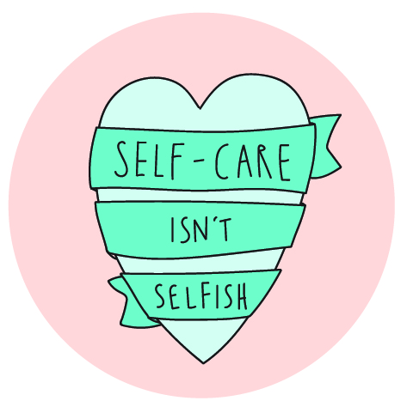
TAKING CARE OF YOURSELF
Self care is the practice of taking time to pay attention to and care for YOU
Why is self-care important?
Helps you manage stress
Improves physical health
Contributes to long-term feelings of well-being
Gives you a break from stress
Gives you time alone
Notes:
What is self-care?
Practice of taking time to pay attention to you
Ensures that you are being cared for by you
Self-care can be practiced every single day
Why self-care is so important
Self-care goes a long way in managing stress and living your best life
Improves your physical health by promoting relaxation
Having a well-cared-for body contributes to long-term feelings of well-being
Self-care gives you a break from stress and offers soothing feelings
Self-care gives you time alone

Slide 5
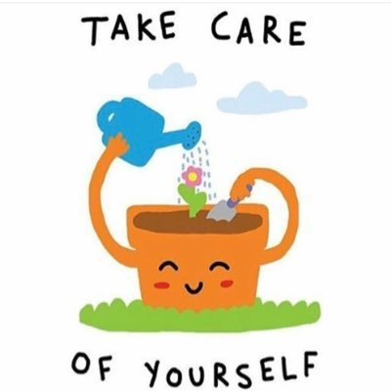
7 TYPES OF SELF-CARE ACTIVITIES
Sensory
Pleasure
Mental/ Mastery
Spiritual
Emotional
Physical
Social
Notes:
Refer to self-care activity handout
Sensory- eg: listening to the outdoors, the sounds around you, enjoying the smell form your favorite candle, listening to music
Pleasure- eg: watching a favorite movie, journaling, crafting
Mental- eg: trying a new activity, doing a word search, cleaning out your closet
Spiritual- eg: reading poetry, praying, thinking about what you are thankful for
Emotional- eg: crying when you need to, writing your feelings down
Physical- eg: yoga going for a walk, napping
Social- eg: calling a friend, going out with a friend
We have a handout for you with more of these activities.

Slide 6
APPS TO HELP WITH STRESS
Calm
Meditation, sleep and mental wellness app
Breathe2Relax
Teaches users to practice relaxing breathing techniques
Happify
Brings you effective tools and programs to help you take control of your feelings and thoughts
Relax Melodies
Over 100 ambient sounds and melodies
Colorfy
Coloring therapy on your mobile
7 Cups
Chat online with caring listeners
Notes:
This is a list of apps that you may find helpful in your future. We will also have this for you on a handout for future reference.

Slide 7
Notes:
Remember:
Self care is about YOU
What YOU need to do to feel good

Slide 8
Notes:
Have students create or fill in the self care plan using ideas that have been taught over the 4 weeks. Printable version can be found in the toolkit (Appendix F)
Self care plan examples:
Mental- eg: trying a new activity, doing a word search, cleaning out your closet
Emotional- eg: crying when you need to, writing your feelings down, journaling
Physical- eg: yoga, going for a walk, napping
Additional resources and ideas for self care activities:
https://mindyourmind.ca/blog/3-tips-start-self-care-everyday-challenge
https://mindyourmind.ca/printouts/self-care-kit-english-and-French

Slide 9
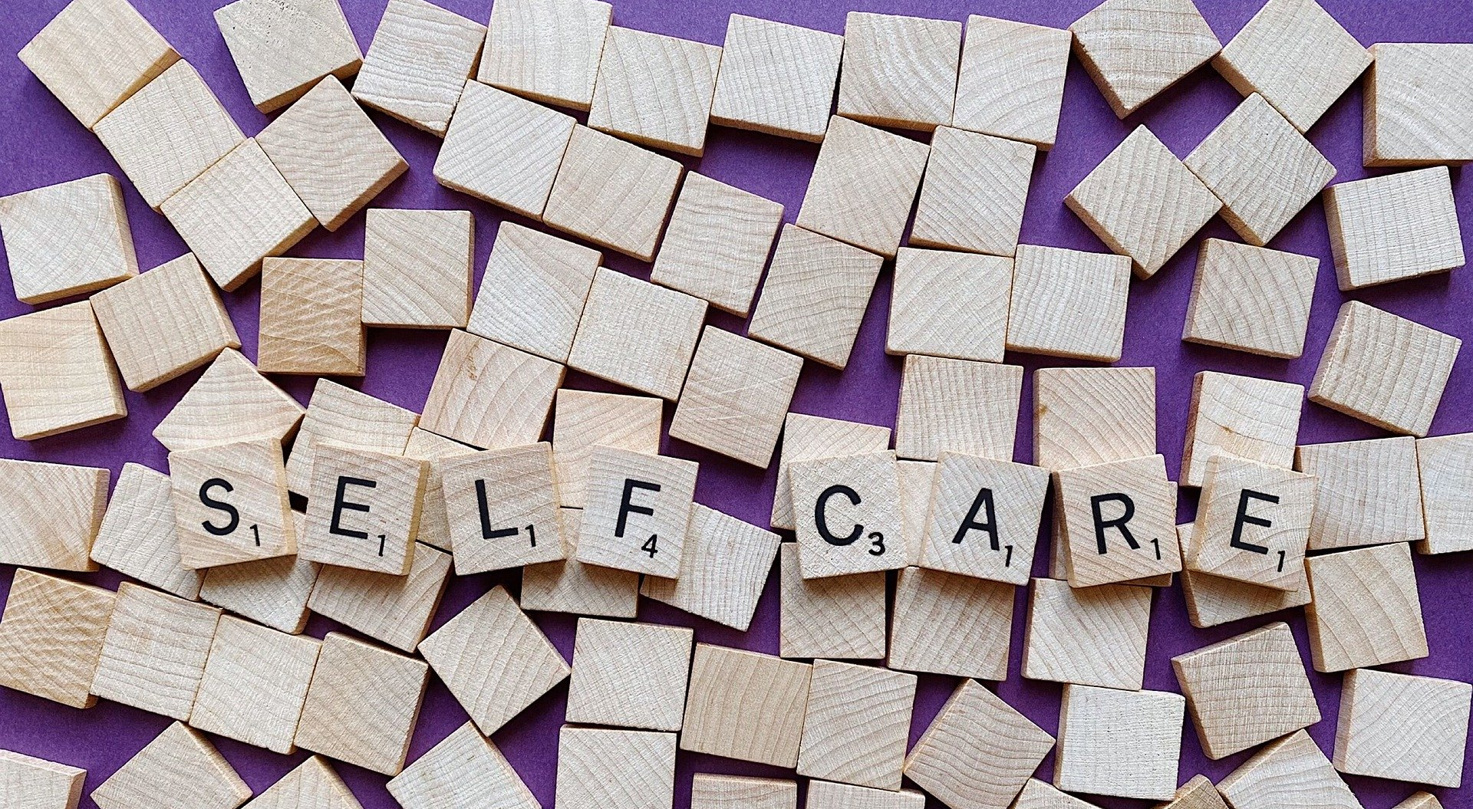
Choose your Self-Care activity!
This Photo by Unknown Author is licensed under CC BY-SA
Notes:
The following slides are some examples of self care activites:
Yoga from youtube for beginners
Jenga Game (can borrow from the HU- ask your School nurse )
Nature walk if possible near the school
Self Care Plan
Choose which activity you are going to do with students.

Slide 10
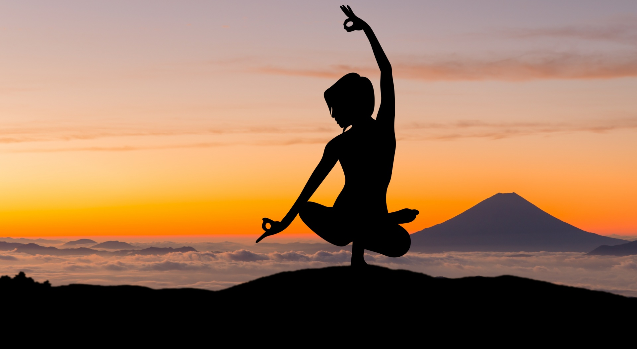
YOGA
Notes:
10 Benefits of Yoga: (rationale for each point can be found in the toolkit, Appendix C)
1. Yoga increases your flexibility.
2. Yoga helps you to build strength.
3. Yoga improves your posture.
4. Yoga helps to keep your joints healthy.
5. Yoga is a powerful mindfulness practice.
6. Yoga reduces stress.
7. Yoga lowers blood pressure.
8. Yoga helps you to make healthier life choices.
9. Yoga improves breathing.
10. Yoga encourages your body’s natural healing process.
https://www.youtube.com/watch?v=7kgZnJqzNaU
Invite a yoga instructor in to lead the class.

Slide 11
JENGA
Notes:
Use the Jenga game questions in the toolkit (Appendix D) to quiz the students on the information taught throughout the 4 weeks.
A regular size and large size Jenga game can be borrowed from your School Nurse.

Slide 12
NATURE WALK/SCAVENGER HUNT
Notes:
Use the Nature Walk scavenger hunt handouts in the toolkit (Appendix E) and take the students on a nature scavenger hunt.

Slide 13
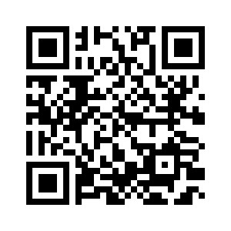
ONLINE STUDENT EVALUATION
Notes:
Have students complete the Mental Wellness Series Student Evaluation- online (https://survey.wechu.org/index.php/491557?lang=en). See the Toolkit for a link to the evaluation or scan the QR code on the slide above.
Provide Wellness Series Student Handbook – link to printable version found in the Toolkit.
Optional: Pull name from box to give prize out

Slide 14
REFERENCES
https://www.psychologytoday.com/ca/blog/shyness-is-nice/201403/seven-types-self-care-activities-coping-stress
https://soundgirls.org/self-care-develop-a-routine-that-works-for-you/
https://www.yogabliss.co.uk/Top-10-Benefits-of-Practicing-Yoga

