Slide 1
MENTAL WELLNESS SERIES
Week 1- Stress and anxiety
Notes:
Materials needed-
Large body outline and stickers or a marker for all students. Alternativley draw a large Person Outline on the white board or chart paper and have students mark the person
iPads (for Kahoot game - optional)
Small papers for evaluation answers
Box or bag to put papers inside
Prizes (optional)
PROGRAM OVERVIEW:
Over the next 4 weeks, you will learn about stress and anxiety, how it affects your life and health and how your body reacts to stress.
We will discuss 3 different coping mechanisms, so that you will have a variety of methods to help you deal with stress in the future.

Slide 2
INTRODUCTION
Everyone write down your first name and something that causes you stress on a piece of paper.
Notes:
Activity- (if there are prizes) Ask students to write their first name on a piece of paper, and something that causes them stress. Advise students that this is an activity to get them thinking about their mental wellness, it is not being marked or shared with the class. Put the answers in the box or bag at the front of the room.
Prizes can be anything. Examples include: a water bottle, a blank notebook, coloured pencils, markers, stickers.
Optional: if there are no prizes, have the students write down something that causes them stress.

Slide 3
MENTAL WELLNESS SERIES
Week 1
Introduction to stress and anxiety
Week 2
Wellness Strategy #1: Physical relaxation
Deep breathing, visualization, progressive relaxation
Week 3
Wellness Strategy #2: Express yourself through art
Coloring, crafts, button making
Week 4
Wellness Strategy #3: Keeping life in a balance
Self-care activities, apps for stress relief
Notes:
Week 1 objectives-
What is stress and anxiety?
What causes stress?
How does stress effect our bodies?
What are healthy and unhealthy ways to cope with stress?
Week 2 objectives-
Physical ways to relax and cope with stress
Opportunities to learn deep breathing, visualization, progressive relaxation
Week 3 objectives-
What is art therapy?
Week 4 objectives-
Discuss self-care
Discuss apps to help with stress

Slide 4
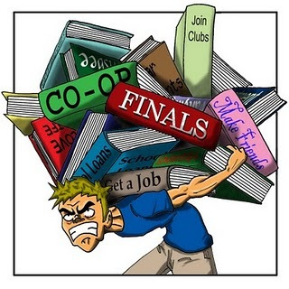
WHAT IS STRESS?
Mental or emotional strain resulting from demanding circumstances
Our body’s automatic response to challenges in our life
Stress can affect our minds and our bodies
Notes:
What is stress?
Stress is the physical or mental response to an external cause. For example: having a lot of homework.
It may be a one-time response, or it may happen repeatedly over a long time.
Stress happens when YOU feel something is demanding, if you feel that you don’t have the skills to meet those demands, you will perceive the situation as stressful.
It’s important to know that stress is a NORMAL part of life, and everyone deals with it.
When we are faced with a stressful situation, our body automatically releases hormones (adrenaline, cortisol, norepinephrine). These hormones can cause physical symptoms in our body:
BP increases
excessive sweating
heart palpitations
headaches
It can also affect our minds. It can cause you to feel:
Restless
Have a hard time focusing
Feel overwhelmed
Cause you to feel anxious (we are going to talk more about this next)
Long term stress can be harmful to our health.
You might feel stress when you are about to take a test. For example, your stomach might hurt, you might be sweaty

Slide 5
SYMPTOMS OF STRESS
Physical symptoms
Low energy, tired
Headaches
Upset stomach
Tense muscles
Heart racing
Shaking, jittery
Emotional symptoms
Moody, agitated
Easily frustrated
Feeling overwhelmed
Loneliness
Unable to focus
Forgetfulness
Constantly worried
Behavior symptoms
Changes in appetite
Procrastinating tasks
Nail biting, fidgeting
Avoidance of daily activities
Notes:
We talked a little about some of the effects that stress has on the body. Remember stress affects our body, mind and behavior. This is a more detailed list of some of the things that one might experience while under stress.
Physical symptoms
Low energy, fatigue, tired (In fact, 26% of teens are sleep deprived, which makes things harder to cope with!)
Headaches
Upset stomach
Tense muscles
Fast heart rate
Shaking, jittery
Emotional/ Mental Symptoms
Moody, agitated
Easily frustrated
Feeling overwhelmed
Loneliness, like nobody understands
Racing thoughts
Unable to focus
Forgetfulness, disorganized thinking
Constantly worried
Behavior Symptoms
Changes in appetite
Procrastinating tasks
Nail biting, fidgeting
Avoidance of daily activities

Slide 6
WHAT IS ANXIETY?
Characterized by feelings of tension and worried thoughts
Excessive or unrealistic worry or fear
Experiencing anxiety does not mean you have an anxiety disorder
Notes:
What is anxiety?
An emotion characterized by internal feelings of tension, worried thoughts and physical changes like:
your heart racing and pounding
sweating
headache
upset stomach
dizziness
even shortness of breath
In some cases, anxiety can be an excessive or unrealistic worry or fear around an event or situation. This is at a different level than what someone might have around a test or exam.
When this level of worry or fear happens for long periods of time, and the person displays several other symptoms, it can be characterized as an anxiety disorder.

Slide 7
SYMPTOMS OF ANXIETY
Feelings of panic, fear, restlessness
Sleep problems, always feeling tired
Cold, sweaty, numb hands or feet
Shortness of breath
Heart racing
Upset stomach
Muscle tension
Could lead to panic attacks
Notes:
Symptoms of Anxiety
Feelings of panic, unrealistic fear, nervousness, restlessness
Sleep problems (can’t fall asleep or stay asleep)
Fatigue
Cold, sweaty, numb hands or feet
Shortness of breath
Heart racing/ palpitations
Upset stomach
Muscle tension
Could lead to panic attacks

Slide 8
STRESS OR ANXIETY
Notes:
HealthyWomen.org

Slide 9
COMMON CAUSES OF STRESS
Academics
Relationships
Balancing life tasks
Pressure from others
Financial worries
Traumatic events
Life changes
*It’s important to identify WHAT is causing you stress.
Notes:
These are some common causes of stress young people.
Academics - Getting good grades, starting high school next year
Relationships - friends, relationship with family, maybe some of you are starting to date
Balancing life tasks - school, friends, sports, hobbies
Pressure from others/ self
Life events- COVID, home life, changing schools
It is important to identify WHAT is causing you stress, that way you can develop a plan to address it

Slide 10
MYTHS ABOUT STRESS
Stress is the same for everybody
Stress is always bad for you
Stress is everywhere, so you can’t do anything about it
The most popular techniques for reducing stress are the best ones
No symptoms, no stress
Only major symptoms require attention
American Psychological Association, www.apa.org, 2019
Notes:
6 MYTHS about stress
Stress is the same for everybody
Stress is different for each of us
What is stressful for one person may or may not be stressful for another
Each of us responds to stress in a different way
Stress is always bad for you
Stress can be positive; it can motivate you to do better
Compare stress in humans like tension on a guitar string- too little and the music is dull and raspy; too much and the music is shrill and the string snaps
The issue with stress is how to manage it
Managed stress makes us productive and happy, mismanaged stress hurts us
Stress is everywhere, so you can’t do anything about it
You can plan your life so that stress does not overwhelm you
Effective planning involves setting priorities and working on simple problems first
When stress is mismanaged, it is difficult to prioritize
The most popular techniques for reducing stress are the best ones
Not true: there is not one perfect technique- you must do what is best for YOU
We are all different, everyone has different situations, and our reactions are different
No symptoms, no stress
Absence of symptoms does not mean absence of stress
Hiding your symptoms of stress with medication may prevent you from realizing how severe the stress is and the importance of realizing the strain that it is having on your body.
Only major symptoms of stress require attention
Minor symptoms such as headaches and stomach aches should not be ignored
Minor symptoms are early warnings that you need to better manage your stress!

Slide 11
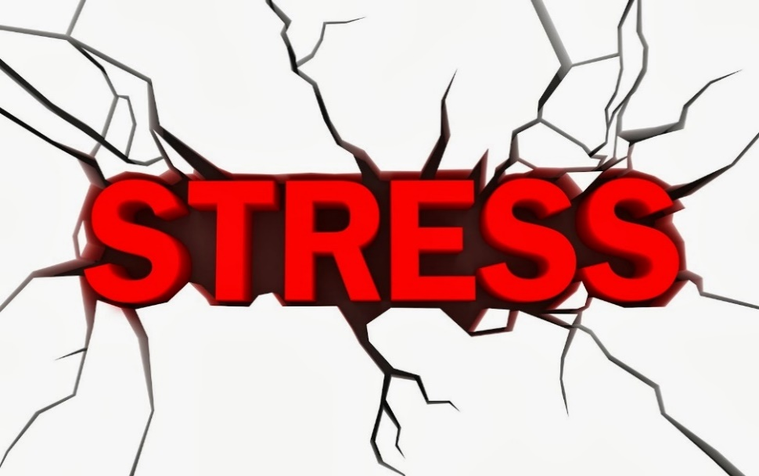
ACUTE vs. CHRONIC STRESS
What is acute stress?
What is chronic stress?
Notes:
Acute Stress
Sudden situation which causes stress for a short time
Ex- writing an exam or giving a presentation
Chronic Stress
Continued, ongoing stressors
Can cause problems in the long run as it exhausts your system, can hurt your immune system which causes you to get sick more often
Ex- living in a dangerous area and feeling unsafe every day

Slide 12
DID YOU KNOW???
This Photo by Unknown Author is licensed under CC BY-NC
Notes:
According to Ontario Student Drug Use Health Survey (2021), 38 % of students in gr 7-12 rate their mental health as fair or poor.

Slide 13
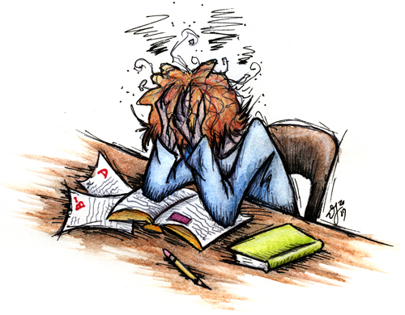
What causes YOU stress?
This Photo by Unknown Author is licensed under CC BY-SA
Notes:
At the beginning of this, we asked you to write down what causes you stress. Think about what you wrote down.
Now think about how you deal with that stress.

Slide 14
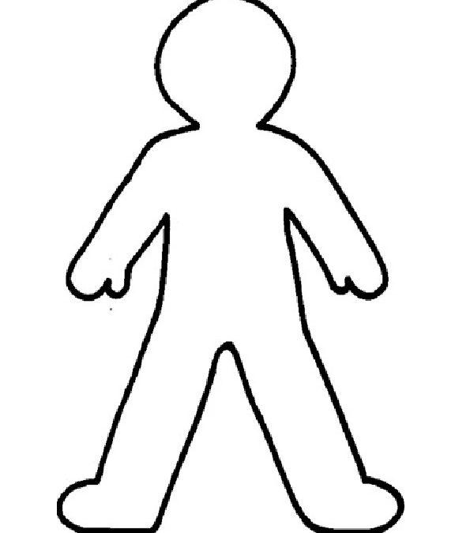
ACTIVITY: SYMPTOMS OF STRESS IN THE BODY
When you’re stressed, where do you feel it in your body?
Notes:
Activity- give students stickers and have them put on body diagram where they feel stress in their body
OR
Draw a large body outline on the whiteboard or a piece of chart paper and have students mark where they feel stress in their body

Slide 15
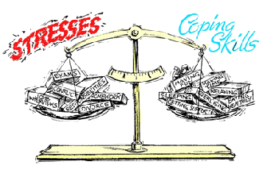
COPING WITH STRESS
What are healthy ways to deal with stress?
What are unhealthy ways to deal with stress?
Notes:
Ask the students: How do we cope with stress?
Everyone has different ways to cope with stress- one way may work for one person, but not another be healthy for one person but unhealthy for another
Healthy ways to cope with stress
Healthy exercise
Relaxation and stress management techniques
Get enough sleep
Eat a healthy diet
Manage your time- stay organized, prioritize
Talk to someone about how you feel
Accept that there are things you cannot change
Unhealthy ways to cope with stress
Substance use (alcohol, drugs, caffeine)
Overeating or undereating
Skipping sleep
Avoidance, procrastination
Withdrawing from friends, family, social events
Taking your stress out on others

Slide 16
STRESS MANAGEMENT TECHNIQUES
Deep breathing
Progressive muscle relaxation
Guided imagery
Yoga/ stretching
Relaxing hobbies (music, art, crafts, reading, cooking)
Time with friends
Physical activity
Be present!
Notes:
Be present – try not to stress about the past or the future, be mindful of where and what you are doing right now.
Over the next three weeks we are going to learn three techniques in detail that will help when you feel stressed. (physical relaxation, art therapy and self care)

Slide 17
EMOTIONAL WELL-BEING
What is emotional well-being?
Why is it important?
Notes:
Our goal of being here is to help you all achieve emotional well-being.
Emotional wellbeing is the ability to understand the value of your emotions and use them to move your life forward in a positive direction.
Young people who have a strong sense of self and who can understand and manage their health and emotions are in a better position to reach their full potential in the future.
Building emotional wellness is all about listening to your body and become aware of what is going on inside you, as well as observing your reactions.

Slide 18
Notes:
Play Stress, Anxiety and YOU game on Kahoot- see instructions in toolkit for accessing Kahoot.
Optional: Pull name from box to give prize out or give a prize to the top 3 students in the Kahoot game.

Slide 19
www.HealthyWomen.org
www.apa.org
https://www.nimh.nih.gov/health/publications/so-stressed-out-fact-sheet
https://www.apa.org/topics/anxiety
https://www.stress.org/teens

