Slide 1
MENTAL WELLNESS SERIES
WEEK 3- Express yourself through art
Notes:
Materials needed
Box to put pieces of paper in
Small papers to put in box
Mandala print outs
Coloring pencils and markers- teacher should have these
Button maker and accessories
Normal sized copy paper- 8 ½ x 11
Tape
Stapler with staples
Masking tape

Slide 2
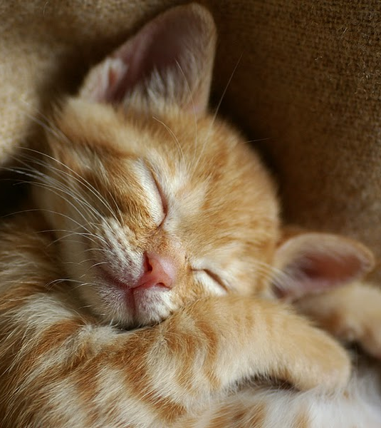
INTRODUCTION
Everyone write down your first name and an unhealthy way to deal with stress.
This Photo by Unknown Author is licensed under CC BY-SA-NC
Notes:
ASK: Last week we talked about 3 different relaxation techniques. Who can tell me what they were? (deep breathing, visualization, progressive muscle relaxation)
Activity- (if there are prizes) Ask students to write their first name on a piece of paper, and an unhealthy way to deal with stress. Advise students that this is an activity to get them thinking about their mental wellness, it is not being marked or shared with the class. Put the answers in the box or bag at the front of the room.
Prizes can be anything. Examples include: a water bottle, a blank notebook, coloured pencils, markers, stickers.
Optional: if there are no prizes, just have the students write down something that causes them stress.

Slide 3
WELLNESS WEDNESDAY’S
Week 1
Introduction to stress and anxiety
Week 2
Wellness Strategy #1: Peaceful movement
Deep breathing, visualization, progressive relaxation
Week 3
Wellness Strategy #2: Express yourself through art
Coloring, craft, button making
Week 4
Wellness Strategy #3: Keeping life in a balance
Self-care activities, apps for stress relief
Notes:
Week 1 objectives-
What is stress and anxiety?
What causes stress?
How does stress effect our bodies?
What are healthy and unhealthy ways to cope with stress?
Week 2 objectives-
Physical ways to cope with stress
Opportunities to learn deep breathing, visualization, progressive relaxation
Week 3 objectives-
What is art therapy?
Opportunities to practice art therapy
Week 4 objectives-
Discuss self-care strategy handout
Discuss apps to help with stress
Activity- physical activity with Wii game

Slide 4
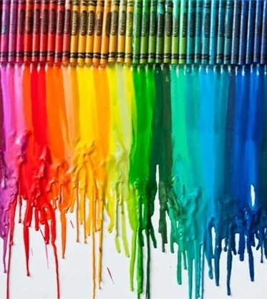
ART FOR RELAXATION
The creative process of making art can enhance mental and emotional well-being
Creating art takes your mind off whatever is causing you stress. It gives you an outlet to channel your energy to something you enjoy
Focusing on art can give you relief from overwhelming thoughts or emotions
Notes:
What is Art Therapy?
A creative process of art making to improve and enhance mental and emotional well-being
Helps resolve conflicts and problems, manage behavior, reduce stress, and develop new skills and hobbies
Can give you relief from overwhelming emotions
Can be a positive, healthy distraction
Doing art regularly can help keep your stress levels down and help you cope when stress does occur

Slide 5
ADVANTAGES OF ART CREATION
Non-judgemental
Individual-lead (you can do whatever art you find enjoyable)
Allows for individual expression
Outlet for feelings you don’t know how to release
Develop creativity
Can be done for cheap or free – depending what you choose
There is no right or wrong way to do this
Notes:
Pros of Art Therapy
Non-judgmental
Individual-lead (can do whatever art YOU find enjoyable)
Allows individual expression
Outlet for bottled up feelings, feelings you don’t know how to release
Develop creativity and other helpful skills
Can be done for cheap or free depending on what you choose
There’s no right or wrong way to do this – you do what you enjoy & create what you want!

Slide 6
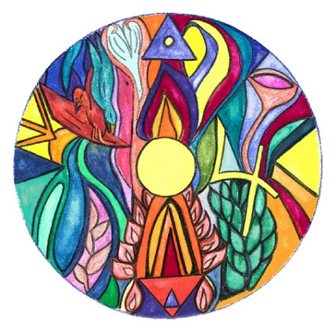
ART RELAXATION
Examples of art options:
Coloring
Drawing or painting
Playing or learning to play music
Making jewelry
Crafting
Notes:
Can you give some other examples?
Origami
Writing or journaling
Baking or cooking
Dancing
According to a 2016 study published in the Journal of the American Art Therapy Association, just 45 min of creative activity can reduce your stress and have a positive effect on your mental health, regardless of artistic experience or talent.

Slide 7
Notes:
If time is limited, you may choose to do just one art activity.
Decide if you would like to work on the art activities as a large group or divided into 2 groups. If doing the airplanes, you may want to divide the class into 2 groups. If you are doing the origami activity with a video tutorial, you may want to work as one large group for both the origami and button making craft.
Divide the class into 2 groups.
It is best to have the teacher help with this as there is usually a process in place.
Group #1 will start with activity #1
Group #2 will start with activity #2
We will spend 20 min on each activity and then switch.
I will read through each activity slide and give the instructions, then start the activities.
Read activity # 3 as well but hand out mandalas at the end of class.

Slide 8
ACTIVITY 1- CRAFTING
Paper Airplane Contest
Build your best paper airplane!
Measure the distance
Notes:
Have students build their best paper airplane (can do this in teams or individually)
Tell students they can only use the following material:
1 pieces of 8.5” x 11” copy paper
Three inches of tape
Three staples
Distance Test Rules
Each student/ team throws their paper airplane. All distances must be measured from the starting line to the point where the plane first touches the floor – not the final resting place it slides. Mark the floor with a piece of masking tape that has the students name on it. Each student/ team gets three chances to get their best distance and time. This can be changed to one or two chances if time is limited.
20 min per group- 10 min to build the airplane
- 10 min to run the contest
**To hide this slide in the presentation if you plan to do origami, right click the slide in the left-hand pane and click “hide slide”.

Slide 9
ACTIVITY 1- ORIGAMI
Origami
Notes:
**To unhide this slide from the presentation, right click on it in the left-hand pane and click “unhide.”
Origami is a great alternative option to airplanes.
The crane video (https://youtu.be/FyC7pkT-dE0) hyperlinked in the slide is a good option for older grades (7/8) but may still be challenging. Please view the video prior to this week’s lesson to determine if one of the videos below may be more suitable. Video length is 14:15 minutes.
Other options: Paper Boat (easy) https://www.youtube.com/watch?v=vNba3jbBSOw – Video length 4:23 minutes – uses standard size printer paper
Jumping Frog (easy) https://www.youtube.com/watch?v=khr_Yjz5AKs – Video length 12:47 minutes
Or to find a video tutorial you would like to try with the class, visit YouTube and search “origami”.

Slide 10
ACTIVITY 2- BUTTON MAKER
Let’s practice!
Notes:
Make a button! Students can put whatever they like on their button (saying, name, picture). That is what is great about art therapy!
You can put the button on your backpack or your lunch bag. Wherever you like!
You can also make a button for a sibling or a friend.

Slide 11
ACTIVITY 3- COLORING
Keep practicing in your free time!
Notes:
4 different printable mandalas as a resource.
Give to the students to take home or keep in their desk to do during free time.
FREE printable mandala pages- http://www.mandala-4free.de

Slide 12
REVIEW
Creating art for relaxation takes your mind off whatever is causing you stress.
It gives you an outlet to channel your energy to something you enjoy doing
Creating art can give you relief from overwhelming thoughts or emotions
Examples include coloring, painting, playing music, crafts, cooking, baking – and many more!
Notes:
Optional: Pull name from box to give prize out

Slide 13
REFERENCES
https://www.ccpa-accp.ca/psychological-benefits-of-art-therapy/#:~:text=It%20encourages%20the%20development%20of,providing%20insight%20into%20traumatic%20experiences.
https://www.verywellmind.com/what-is-art-therapy-2795755#toc-benefits-of-art-therapy
https://www.teachengineering.org/activities/view/cub_airplanes_lesson06_activity1
http://www.mandala-4free.de

