Slide 1
MENTAL WELLNESS SERIES
WEEK 2- Peaceful Movement
Notes:
Materials needed
Guided imagery PDF printout- not sure we are giving one out
Box to put pieces of paper in
Small papers to put in box
Pencils
Prizes

Slide 2
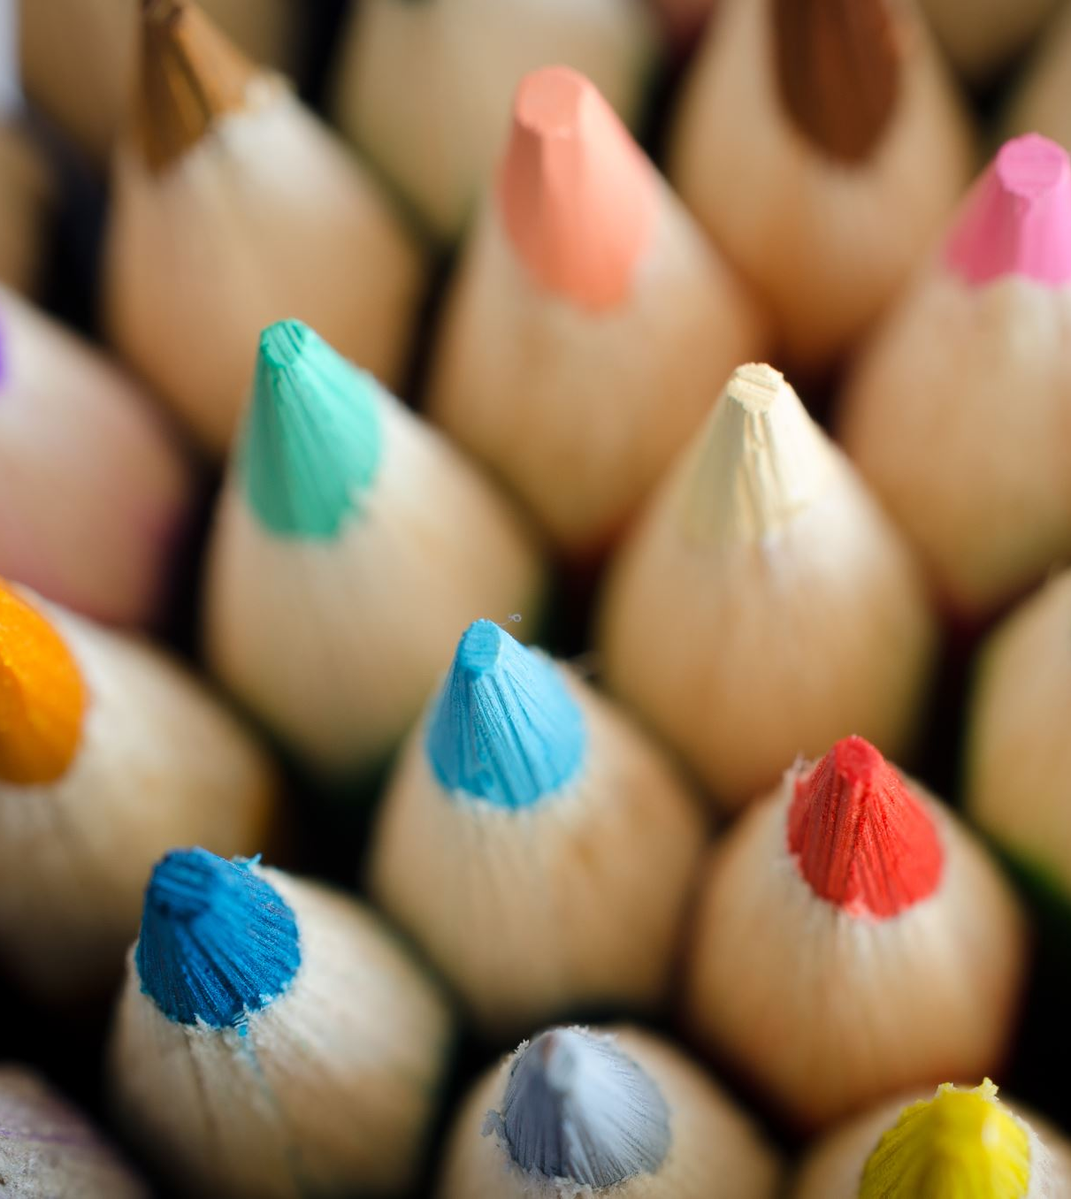
INTRODUCTION
Everyone write down your first name and a healthy way to cope with stress.
Notes:
ASK: Last week we talked about stress and anxiety. Can anyone tell me the difference between stress and anxiety?
Activity- (if there are prizes) Ask students to write their first name on a piece of paper, and a healthy way to cope with stress. Advise students that this is an activity to get them thinking about their mental wellness, it is not being marked or shared with the class. Put the answers in the box or bag at the front of the room.
Prizes can be anything. Eg include: a water bottle, a blank note book, coloured pencils, markers, stickers.
Optional: if there are no prizes, just have the students write down a healthy way to cope with stress.

Slide 3
MENTAL WELLNESS SERIES
Week 1
Introduction to stress and anxiety
Week 2
Wellness Strategy #1: Peaceful movement
Deep breathing, visualization, progressive relaxation
Week 3
Wellness Strategy #2: Express yourself through art
Coloring, crafts, button making
Week 4
Wellness Strategy #3: Keeping life in a balance
Self-care activities, apps for stress relief
Notes:
Week 1 objectives-
What is stress and anxiety?
What causes stress?
How does stress effect our bodies?
What are healthy and unhealthy ways to cope with stress?
Week 2 objectives-
Physical ways to cope with stress
Opportunities to learn deep breathing, visualization, progressive relaxation
Week 3 objectives-
What is art therapy?
Opportunities to practice art therapy
Week 4 objectives-
Discuss self-care strategy handout
Discuss apps to help with stress
Activity- physical activity with Wii game

Slide 4
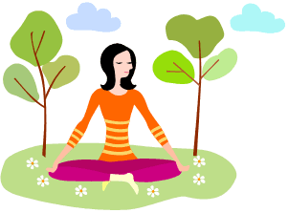
WHAT IS RELAXATION?
Relaxation is the state of being free from tension and anxiety
Physical relaxation refers to physical actions we can take to relax our mind and our bodies

Slide 5
PHYSICAL RELAXATION TECHNIQUES
There are many techniques, we are going to focus on three:
Deep breathing
Guided imagery / visualization
Progressive muscle relaxation
Notes:
There are many different relaxation techniques that you can use to help manage and cope with stress. These three are great because you don’t need special equipment or even a lot of time – you can do them basically anywhere, at any time, easily.
These techniques will help our minds to refocus, move our thoughts away from the stressor and towards relaxing our mind and body.
By focusing our thoughts on something simple and peaceful, it will help settle our mind and our body.
Remember – these can take practice to get good at, so keep at it! If you find one works better for you, keep using that one as you need it. It’s personal preference.

Slide 6
DEEP BREATHING
Deep breathing is a simple yet effective method of relaxation
Most of us spend our time breathing shallow, filling only the upper part of the chest with air
Deep breathing can decrease stress, lower your blood pressure and slow your heart rate
Notes:
Deep breathing is a simple yet effective method of relaxation.
Most of us spend our time breathing shallow, filling only the upper part of the chest with air.
Deep breathing can decrease stress, lower your blood pressure and slow your heart rate.

Slide 7
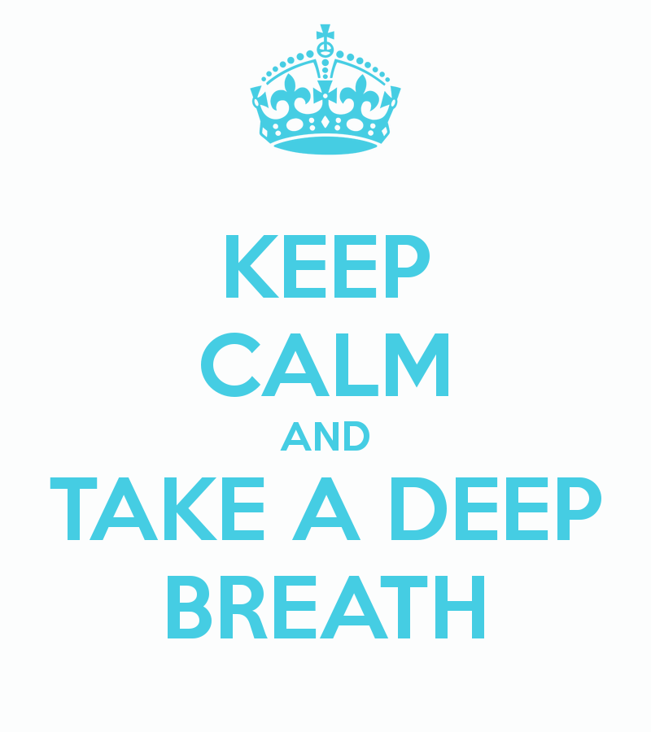
LET’S PRACTICE
Notes:
Now we are going to practice! I will talk you through one round first and then we will sit quietly and you can practice for a minute on your own.
Find a comfortable, quiet place to sit or lie down. Choose a spot where you know you won’t be disturbed. Close your eyes.
Place one hand on your belly, just below your ribs. Place the other hand on your chest.
Take a regular breath
Now, take a slow, deep breath. Breathe in slowly through your nose. Pay attention as your belly swells up under your hand.
Holding your breath, pause for a second or two.
Slowly breathe out through your mouth. Pay attention as the hand on your belly goes in with the breath.
Do this several times until you have a calming rhythm.
Let's practice this for 1 full minute. I will tell you when the time is up.

Slide 8
GUIDED IMAGERY
Guided imagery is a type of focused relaxation. Focused relaxation involves concentrating on a specific object, sound, or experience in order to calm your mind.
In guided imagery, you intentionally think of a peaceful place or scenario.
The goal is to promote a calm state through relaxation and mindfulness. The idea is that your body reacts to your own thoughts.
Notes:
Our second technique is guided imagery.
Guided imagery is a type of focused relaxation. Focused relaxation involves concentrating on a specific object, sound, or experience in order to calm your mind.
In guided imagery, you intentionally think of a peaceful place or scenario. The goal is to promote a calm state through relaxation and mindfulness. The idea is that your body reacts to your own thoughts.
For example, when you think about a stressful situation, your body and mind become tense. Your heart rate and blood pressure might increase, and you may feel jittery and unfocused.
But if you focus your attention on pleasant scenarios, your mind and body tend to relax. You may feel less tightness and tension in your muscles, while your mind might feel calmer and more at ease.
Again, calming your mind and body, you may be better able to cope with mental, emotional, and physical stress.

Slide 9
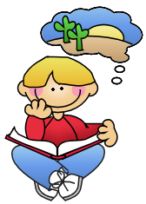
LET’S PRACTICE
5 Minute Mindfulness Meditation
Notes:
We are going to watch a video that will take you through a short segment of guided imagery. Normally you would practice guided imagery for 10-15 min. You can find a lot of these types of video’s online so it is easy to do. Just set yourself up on your phone with your earbuds and you are ready to go.
Video options:
5 Minute Mindfulness Meditation
https://youtu.be/gU_ABFUAVAs

Slide 10
PROGRESSIVE MUSCLE RELAXATION
Teaches you how to relax your muscles through a two-step process.
First, you tense specific muscle groups in your body, such as your neck and shoulders.
Next, you release the tension and notice how your muscles feel when you relax them.
Outcome: lowers your overall stress levels, helps you relax when you are feeling anxious, reduce physical problems like stomach aches, headaches, and it can improve your sleep.
Notes:
Progressive Muscle Relaxation teaches you how to relax your muscles through a two-step process.
First, you tense specific muscle groups in your body, such as your neck and shoulders.
Next, you release the tension and notice how your muscles feel when you relax them.
This exercise will help you to lower your overall tension and stress levels, and help you relax when you are feeling anxious. It can also help reduce physical problems such as stomach aches and headaches, as well as improve your sleep.

Slide 11
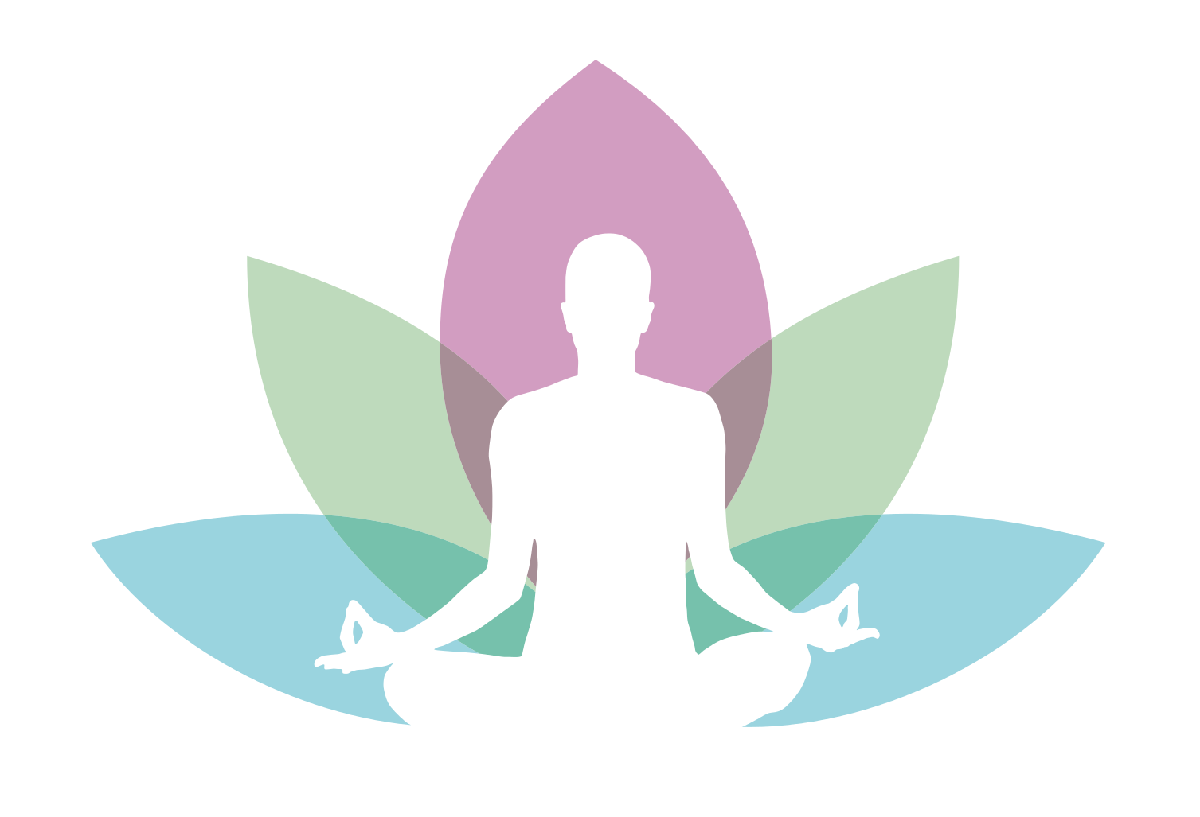
LET’S PRACTICE
Notes:
HELPFUL HINTS:
Set aside about 15 minutes to complete this exercise
Find a place where you can complete this exercise without being disturbed
For the first week or two, practice this exercise twice a day until you get the hang of it. The better you become at it, the quicker the relaxation response will “kick in” when you really need it
You do not need to be feeling anxious when you practice this exercise. In fact, it is better to first practice it when you are calm. That way, it will be easier to do when feeling anxious
Activity from you tube- 10 min video https://www.youtube.com/watch?v=IZub-H2G4d4
OR
Activity- read these instructions and have students follow along
We are going to do the full body today. We will start with our feet and move upwards to our forehead.
Find a comfortable, quiet place to sit or lie down. Choose a spot where you know you won’t be disturbed. Close your eyes.
Place one hand on your belly, just below your ribs. Place the other hand on your chest.
Perform 5-10 deep breaths, allowing your body to relax and your heart rate to slow.
Working from our feet we are going to apply tension to a specific muscle by squeezing it for about 5 seconds while we inhale. Really focus on the feeling of this tension- if it feels uncomfortable, or if it makes the body part shake.
Follow this by relaxing the muscle group, releasing all of the tension you created while exhaling your breath out of your mouth.
*if you’re short on time, group a few muscle groups together* (lower limbs- feet, calves; upper body- arms, hands, shoulder, neck)
Lets start:
Feet (together)
Lower leg (calf, pull toes up toward shin)
Upper leg (quads)
Stomach (suck your stomach in)
Glutes (squeeze together)
Chest (squeeze together)
Shoulders & neck (shrug)
Entire arm (flex bicep)
Hands (make fist)
Mouth (squeeze lips together)
Eyes (clench tightly closed)
Forehead (raise your eyebrows, scowl)
If you find a muscle group you have a hard time connecting to, or still feels tense, go back to it and tense/relax until it feels fully relaxed.
When you’re ready, slowly open your eyes continuing to breathe deeply. Take your time getting up and moving onto other tasks.

Slide 12
REVIEW
Relaxation is the state of being free from tension and anxiety
Physical relaxation techniques help us refocus our minds from stressful thoughts
Physical relaxation techniques we practiced today are deep breathing, visualization and progressive muscle relaxation
Notes:
Remember: these techniques take time to master, give yourself time to practice and get comfortable with them.
Optional: Pull name from box to give prize out

Slide 13
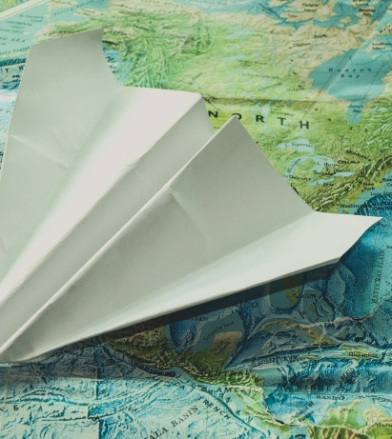
NEXT WEEK…
Paper Airplane Contest
Notes:
Encourage students to look up how to make a paper airplane so that they are prepared for the paper airplane contest.

Slide 14
REFERENCES
https://www.anxietycanada.com/articles/how-to-do-progressive-muscle-relaxation/
https://www.healthline.com/health/guided-imagery

