Slide 1
ANATOMY AND SEXUAL HEALTH
Name of Presenter
Date

Slide 2
ANATOMY AND SEXUAL HEALTH
This information was developed by the Comprehensive Health Promotion Public Health Nurses for teachers to use to assist in teaching Anatomy and Sexual Health.

Slide 3

GROUND RULES
ALL questions are good questions
It’s ok to giggle or be embarrassed
Use correct terms
Respect others’ points of view
No personal questions
Discussions are confidential. With 2 exceptions: disclosure of suicidal thoughts OR disclosure of abuse by a caregiver.
Notes:
Review ground rules.

Slide 4

ICE BREAKER
Notes:
Ask the students to introduce themselves and list their favourite… (choose from the list below):
Movie
TV series
Snack
Meal
Restaurant
Song
Colour
Or choose your own icebreaker.

Slide 5
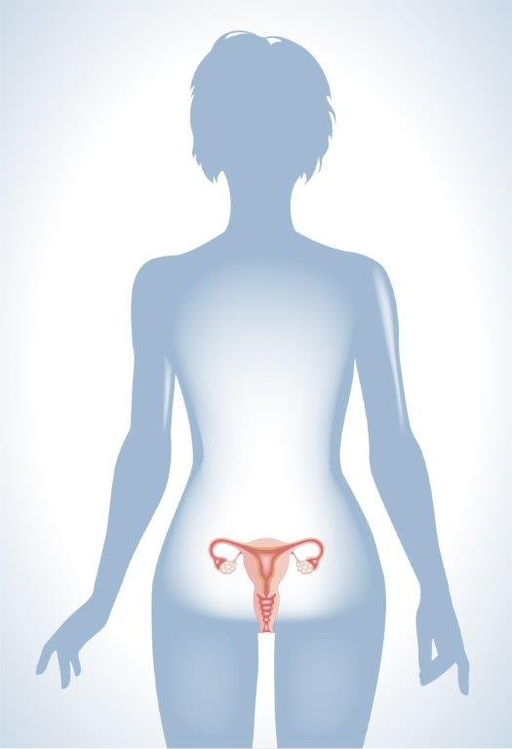
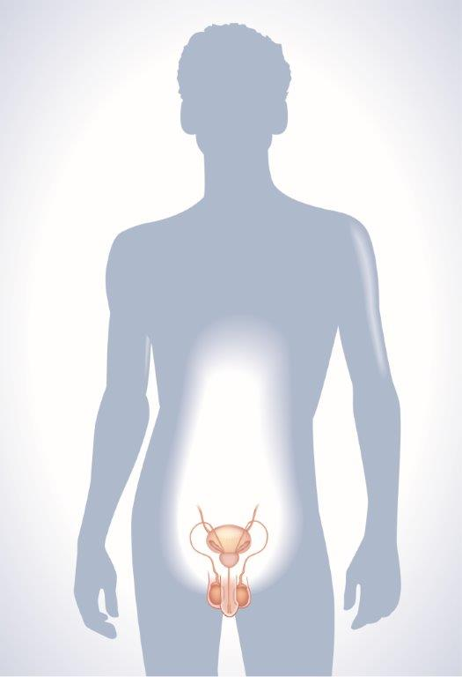
ANATOMY
Notes:
For this presentation, discussion will take place referring to male and female or boys and girls.
To learn about how babies are made, we need to know about our body parts and what they do. We learned about puberty in our previous presentation, about puberty and hygiene, when we talked about our bodies changing and growing. Today we will learn more about our private body parts or genitals. And we will learn about how the inside body parts are used to make babies. We’ll use the science or doctor words for body parts. The words might be new, so they may seem strange at first.
Explain to the students that we cannot see our internal organs so we have to imagine that we can see them in our bodies.
We all have them, but reality is, most of us do not talk about them. Some of us may title them as “privates” and others may laugh/blush and whisper “down there”. Though, the fact is that your reproductive parts are not any more embarrassing than your feet or your nose, it is just that they are covered up most of the time.

Slide 6
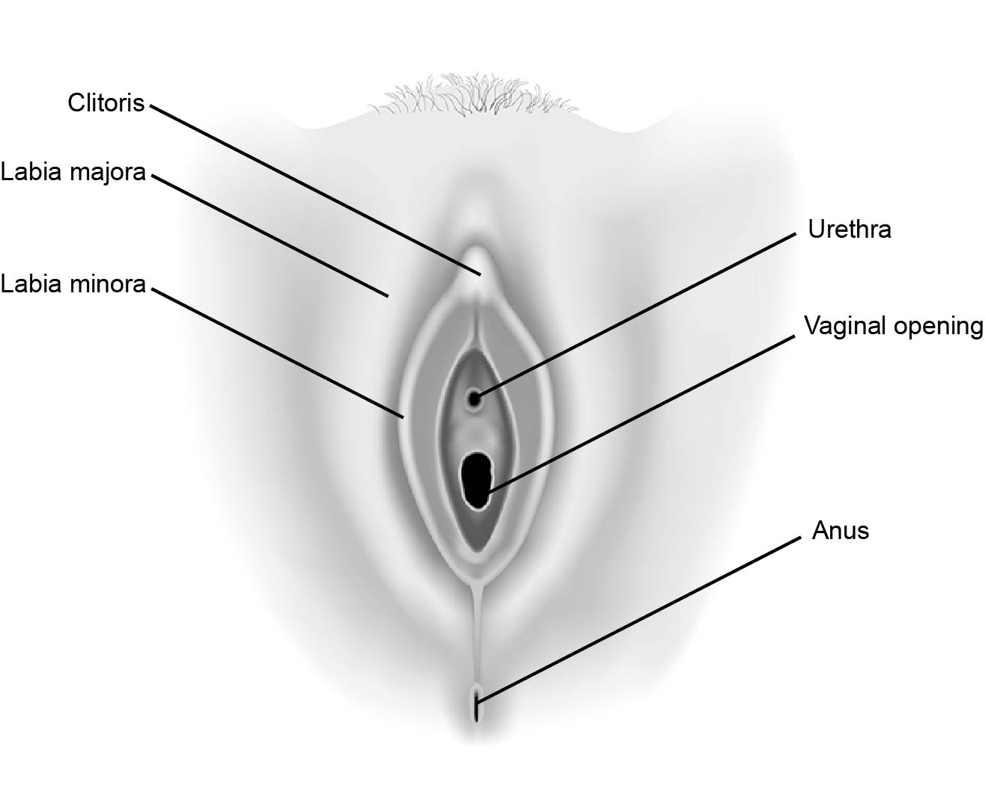
FEMALE EXTERNAL GENITALS
Notes:
Anatomy: (Explain to the students that this is a picture of a female lying down and the area between her legs)
Labia - are two sets of soft folds of skin inside the vulva. Labia majora and labia minora.
Vaginal opening – opening into the vagina.
Clitoris- part of female’s genitals which is full of nerves.
Fallopian Tubes- narrow tubes that connect the ovaries to the uterus, fertilization occurs here.
Urethra- the tube through which urine passes the body, part of the urinary system.
Anus-the opening at the end of the digestive tract where feces or stool leaves the body. Part of the digestive tract.

Slide 7
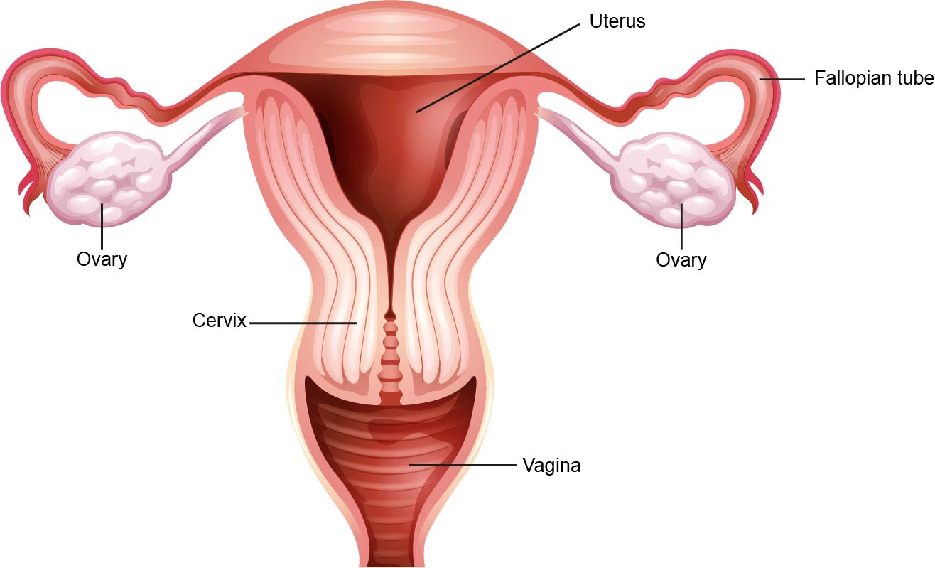
FEMALE REPRODUCTIVE PARTS
Notes:
Anatomy:
Vagina – connects to the uterus where menstrual blood, vaginal intercourse, and child birth occurs. Not used for urination
Cervix- is at the bottom of the uterus that opens into the vagina.
Uterus – the place where a baby grows when a woman is pregnant, feeds and protects baby. Also called the womb.
Fallopian Tubes- narrow tubes that connect the ovaries to the uterus, fertilization occurs here.
Ovaries– are two small organs (the size of your thumb nail) where the egg is made

Slide 8
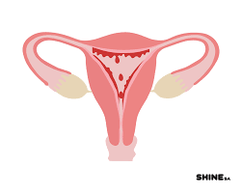
MENSTRUATION
The lining of the uterus is shed from the body.
Notes:
Read the slide.
Once a month, an ovary releases an egg. The lining of the uterus also gets thicker to prepare the body to grow a baby. If that egg is not fertilized with sperm from the male, your body has to get rid of it. 4–6 tablespoons of blood is shed through the vagina as it is not needed.
Usually, menstruation happens once a month and can last from 3-7 days.
Menstruation can begin as early as 8 or as late as 16. Every girl is different.
Additional Information
Menstrual cramps may be uncomfortable either before or during a period.
Treatment: A hot water bottle, a heating bag or moderate exercise can relieve cramps. If cramps become severe then visiting the doctor to discuss solutions is advised
PMS (pre-menstrual syndrome) can occur any time in the two weeks before menstruation. It can make a woman feel moody, irritable, have tender breasts or bloating. Exercising and avoiding caffeine and salt can minimize the symptoms of PMS

Slide 9
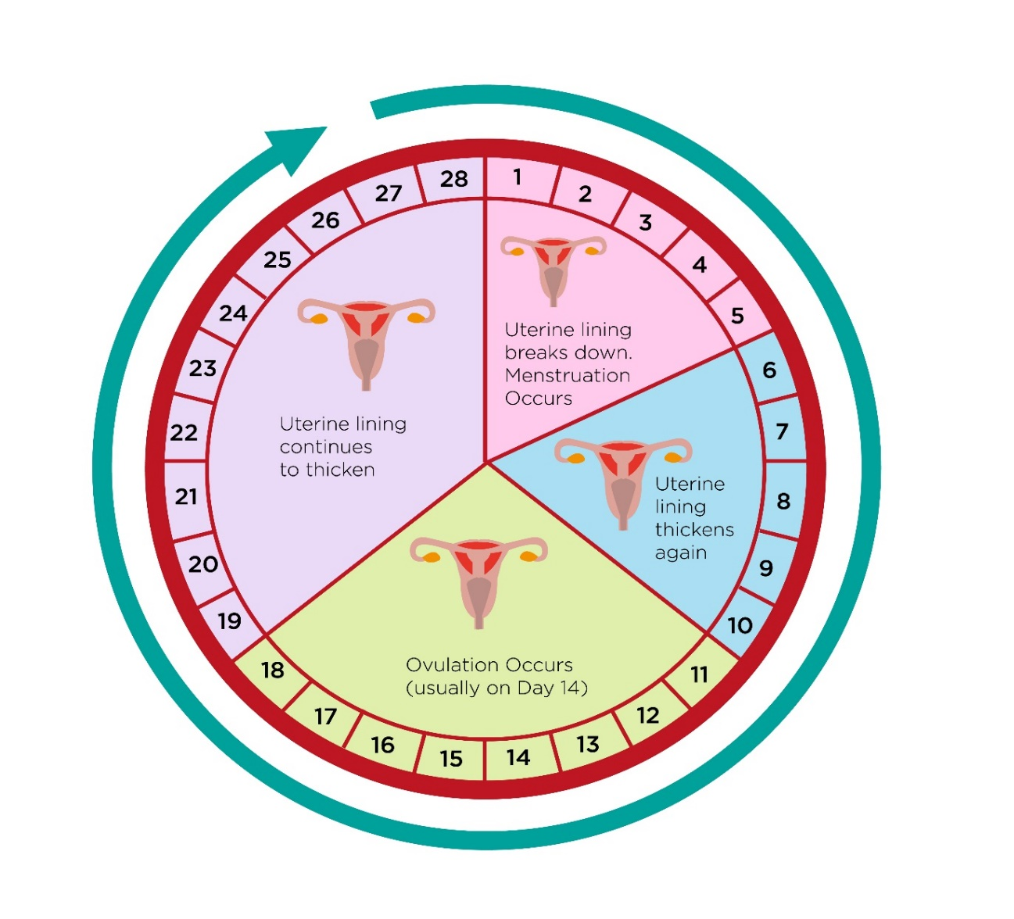
MENSTRUATION
Notes:
Review the diagram with the class:
Days 1-5: This is when a woman has her period, the uterine lining is shed from the body. This menstrual flow consists of blood, mucous, and other tissues.
Days 6-10: The lining of the uterus grows thicker in preparation for a fertilized ovum. One ovum begins to develop inside a follicle in an ovary.
Day 11-18: This is when a woman is ovulating. The ripe ovum breaks away from the follicle and ovary. It will enter the fallopian tube where fertilization can take place.
Day 18-28: If there is no fertilization, the lining of the uterus is not needed and starts to break down. Around the 28th day, it will leave the uterus as menstrual flow, and a new menstrual cycle will begin.
Having a period is private. It is not something that should be talked about in public as this can embarrass others. Girls often feel most comfortable talking with a woman they trust (parent/guardian, aunt, sister) or their health care provider if they have questions.
Additional Information
Days 1-5: Fertilization has not occurred, there is a sloughing off of the uterine lining.
Days 6-10: The follicle with the ripe ovum will move towards the surface of the ovary.
Day 11-18: If fertilization does not occur, the ovum will disintegrate in 24 to 48 hours.

Slide 10
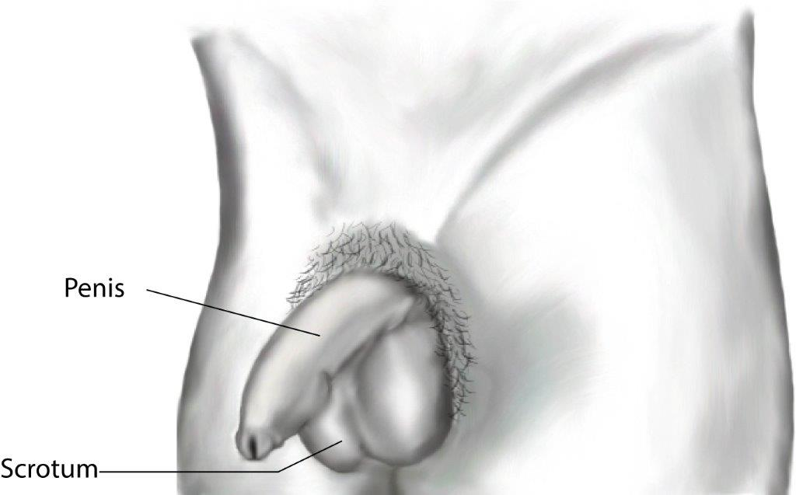
MALE EXTERNAL GENITALS
Notes:
Anatomy:
Penis- made of spongy material that fills up with extra blood and can become hard. Semen and urine come from the penis
Scrotum- a sac that holds the testicles, which must be kept at a certain temperature just below body temperature in order to produce healthy sperm. The scrotum will pull the testicles closer to the body if it is cold and lower away from the body if it is hot

Slide 11
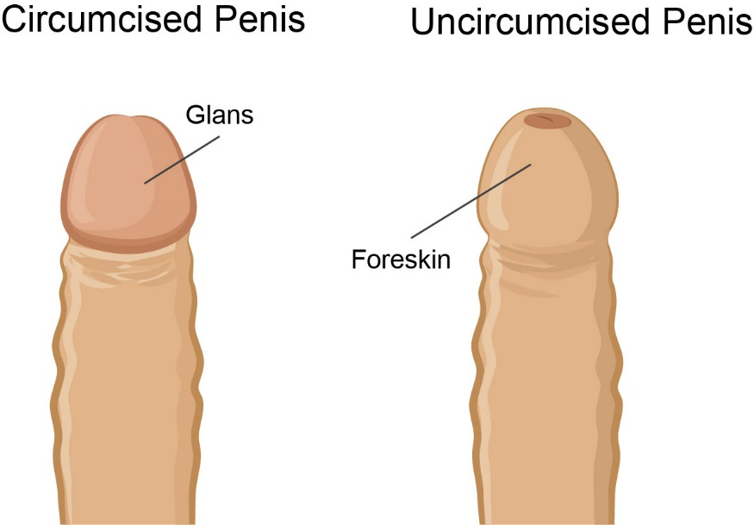
CIRCUMSIZED VS UNCIRCUMSIZED
Notes:
Circumcision is a procedure to remove the foreskin from the penis. It is usually done soon after birth by a doctor or trained religious person. Some people are circumcised, and some are not. It doesn’t affect the function of the penis. There is not usually a medical or health reason for circumcision. It is done or not done for personal reasons.

Slide 12
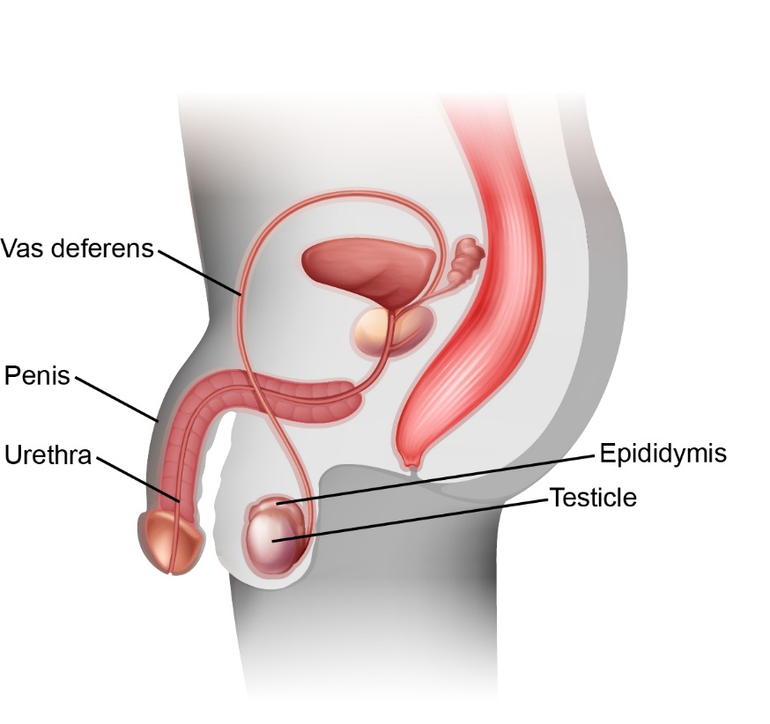
MALE REPRODUCTIVE PARTS
Notes:
Anatomy:
Testicles- held in the scrotum, male sex glands. They are outside of the body so that they can stay cooler than body temperature for healthy sperm production. It is normal for one to hang lower. It is a sensitive area; it is important to protect the testicles during contact sports.
Epididymis- tube that is attached to the testicle. The sperm cells move from the testicle to the epididymis where they are stored and finish maturing.
Vas Deferens- narrow tube that carries sperm from the testicles to the urethra.
Urethra- urine and semen pass through this tube to the outside of the body. Urine and semen cannot come out at the same time. There are two branches to the urethra, one from the bladder and one from the vas deferens. When the penis is ready to release semen, a valve blocks off the branch to the bladder so urine cannot escape.

Slide 13
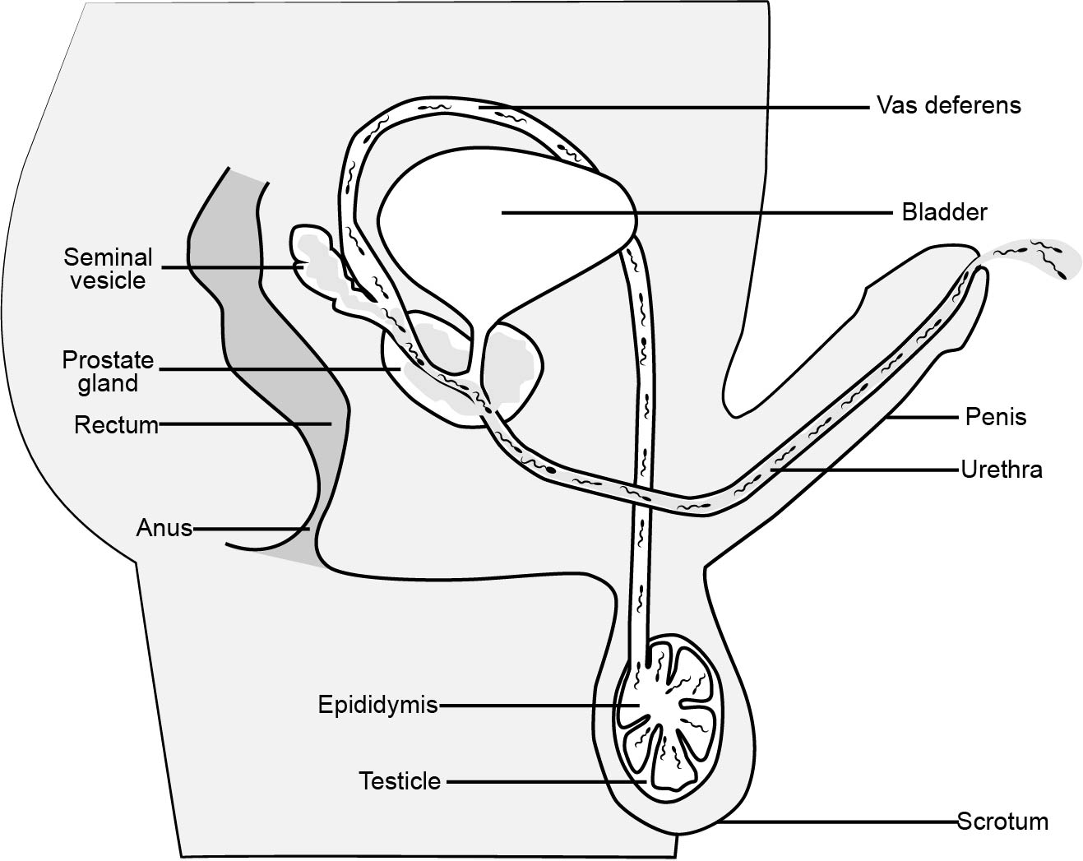
SPERM PRODUCTION
Notes:
Millions of sperm are made every day in the testicles and stored in the epididymis.
The sperm travel up the vas deferens and mix with fluid from the seminal vesicle and prostate to form whitish sticky fluid called semen.
Semen comes out of the penis- this is called ejaculation. Each sperm is very small; there are over 300 million sperm in 5 ml of semen. You cannot see sperm with your eye, you need a microscope.
Addition information
Sperm that are not released through ejaculation are reabsorbed by the body.

Slide 14

DISCUSSION
Notes:
We have discussed the male and female body parts. Now we are going to talk about what happens when you put your body parts together.
What is vaginal intercourse?
During intercourse, the penis on the male is inserted into the vagina of a female.
During intercourse, the male will have something happen called ejaculation.
When ejaculation happens in the vagina, up to 200 million sperm are released.
Only one sperm is needed to make a baby.
Now, let's look at this closer.

Slide 15
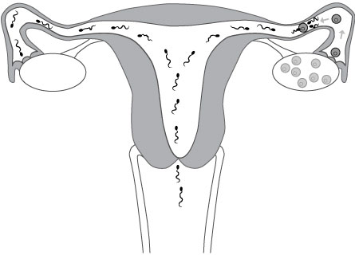
FERTILIZATION
Notes:
Sperm are ejaculated into the vagina and begin swimming up past the cervix, through the uterus and into the fallopian tubes.
The tail of each sperm cell acts as a propeller to move the sperm forward. The first sperm will enter the fallopian tube minutes after ejaculation and can live in the fallopian tubes/uterus for up to five days.
If the sperm finds an egg in the fallopian tube, it will try to attach itself into the egg. Only one sperm will be successful in attaching to the egg, this is called fertilization.
Once one sperm has attached to the egg, the outer membrane or the outside of the egg changes and prevents any other sperm from attaching to it.

Slide 16
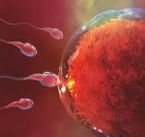
Picture of sperm trying to penetrate the egg.

Slide 17
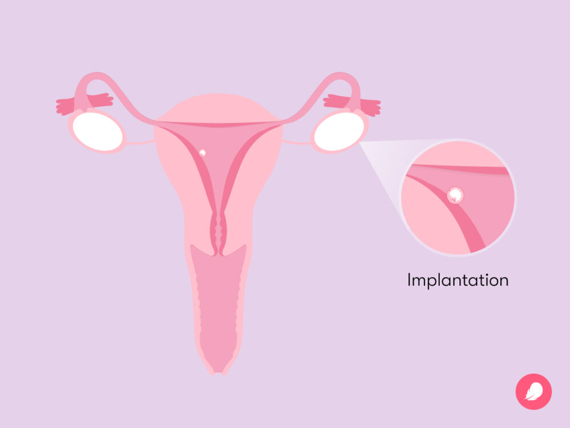
IMPLANTATION
Notes:
After the sperm and egg unite, the fertilized egg travels down the rest of the fallopian tube and into the uterus.
The fertilized egg implants into the lining of the uterus, creating a pregnancy.

Slide 18
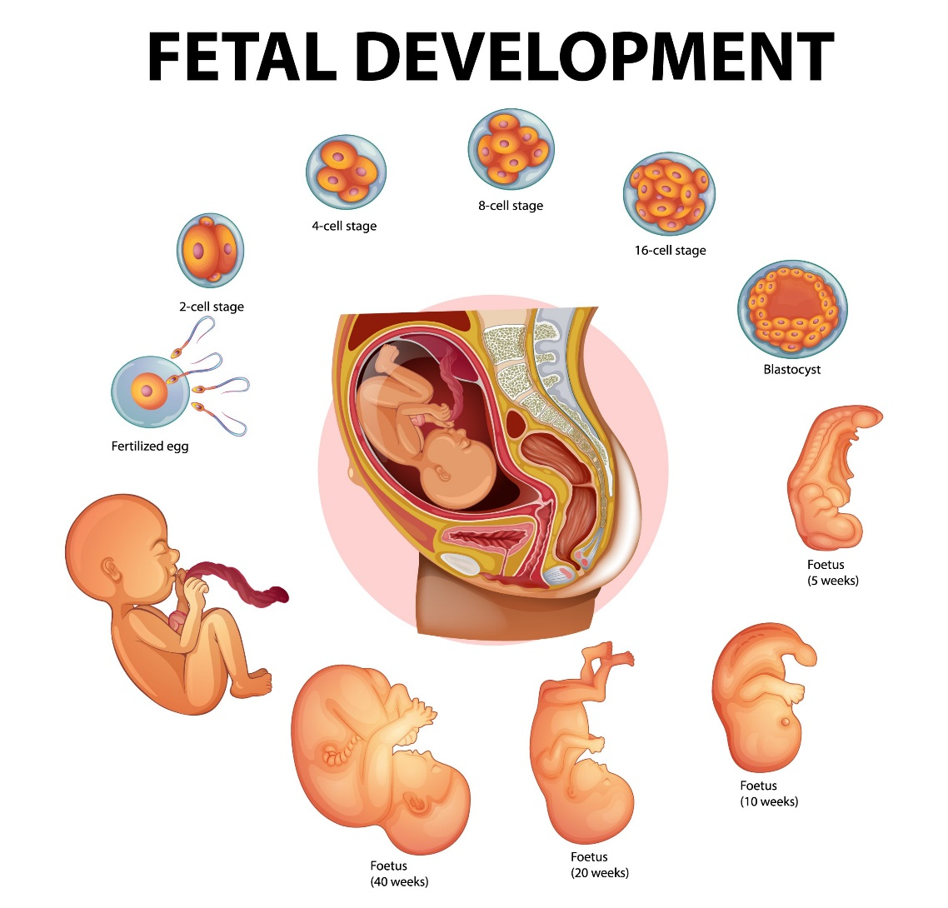
Notes:
Once the egg cell is implanted, a baby starts to grow.
This picture is to show you the size differences from the beginning of pregnancy to the end.

Slide 19
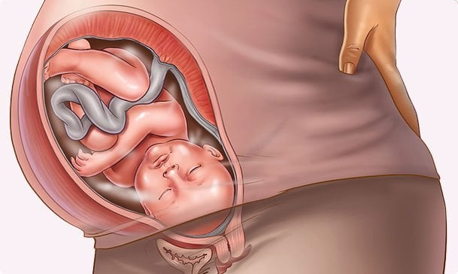
Notes:
This is a baby that is in the womb and ready to be born.

Slide 20
BIRTH CONTROL METHODS
Abstinence
Hormonal Methods
Barrier Methods
Notes:
Birth control methods are split up into 3 groups/categories:
Abstinence - no intercourse at all.
Hormonal methods – for females only, generally work by putting the ovaries to sleep. If an egg is not being released the pregnancy can’t happen.
Barrier methods – available to men and women, prevent pregnancy by preventing sperm from entering the body.
Choosing not to have intercourse is the only 100% guarantee that there will not be a pregnancy.
Additional information
Hormonal Methods: (Protect against pregnancy but do not protect against STBBI’s)
Birth Control Pill
Pill that contains hormones is taken everyday to prevent pregnancy.
The hormones stop the ovaries from releasing an egg.
99.7% effective with perfect use.
NuvaRing
Monthly method.
Flexible oval shaped ring self-inserted into vagina.
Releases low doses of estrogen and progestin.
Wear ring for 3 weeks, take out for one week (to allow for period).
99.7% effective.
Depo-Provera Injection
Injection of progestin every 3 months.
99.8% effective.
Disadvantage – Can cause irregular bleeding, weight gain and can affect bone density later in life.
Intrauterine System (Mirena IUS)
T-shaped device inserted in uterus.
A hormone is released over time to create a cervical mucus plug.
Can stay in uterus up to 5 years.
99.2% effective.
Barrier Methods: (protect against pregnancy and STBBIs)
Internal Condom
Soft, plastic sleeve with two flexible rings, one on each end. The closed, inner ring goes inside the vagina. The outer ring stays outside the vagina to cover the genitals.
Used for vaginal sex
95% effective with perfect use (following exact directions for use)
External Condom
Thin covering that fits over a hard penis
Can be used for oral, vaginal and anal sex
82% effective
SAFER SEX- STAYING SAFE
Abstaining from sexual activity is the only sure way of avoiding the risk of pregnancy or STBBIs. When students receive information about abstinence and birth control methods, they are better prepared to make healthy decisions about having sex.
What does safer sex mean?
• Any type of sexual contact involves some risk.
• To make sexual activity as safe as possible involves planning ahead by:
- talking to your partner about their past relationships e.g., have they been
tested for STBBIs
- using condoms and contraception correctly
- getting tested and treated for STBBIs
- choosing abstinence or delaying the decision to have sex
REMEMBER: Nobody should force you to have sex or do anything sexual that you do not want to do. That is sexual assault and is against the law.

Slide 21
Sexually Transmitted and Blood Borne Infections (STBBIs)
Human Papillomavirus (HPV)
Gonorrhea
Syphilis
Chlamydia
Trichomoniasis
Human Immunodeficiency virus (HIV)
Hepatitis B
Notes:
STBBIs are infections spread primarily by close sexual contact and sexual intercourse. Sexual contact means any intimate skin-to skin contact in the genital area. This includes touching or oral, vaginal, or anal sexual activity with partners of any gender. Examples include chlamydia, gonorrhea, syphilis, and HPV
Blood-borne infections are passed from one person to another through an exchange of blood and other body fluids. Examples include HIV, hepatitis B and hepatitis C . They can also be passed through childbirth or breastfeeding, to a baby. Body piercing or tattooing with non-sterile equipment. Sharing needles, pipes, or straws for drug use.
The only sure way to avoid STBBIs is to abstain from any activity that involves sexual contact between one person’s body and another person’s genital area, semen, vaginal fluid or blood.
HPV- spread through sexual contact. There are more than 100 strains. They can cause genital warts and some types of cancer. A vaccine is available for people of all genders.
Gonorrhea- spread through unprotected sexual contact. Many people have no symptoms while others will have discharge from the penis, vagina or burning when peeing. Treated with antibiotics.
Syphilis- spread through unprotected sexual contact. Many have no symptoms while others have sores on or near their penis, vagina, mouth or rectum. If untreated, it cause blindness and more. Treated with antibiotics.
Chlamydia- a serious bacterial infection spread through unprotected sexual contact. Up to 90% of people with chlamydia do not have symptoms. If left untreated, it can cause serious, long-term effects. PID, infertility, scarring of FT. Treated with antibiotics.
Trichomoniasis- caused by a parasite commonly found in vagina/urethra. Spread through sexual activity. Many don’t show symptoms, some have itchy genitals or burning when they pee. Treated with antibiotics.
HIV- Spread through unprotected sexual contact or by sharing needles. Can lead to AIDS. There is no cure, but if found early and given treatment, people can stay healthy and live a long time.
Hepatitis B- spread through blood and bodily fluids. Most recover, in rare cases, it’s deadly. Anti-viral meds. A vaccine is available.

Slide 22

QUESTIONS

Slide 23
References
https://teachingsexualhealth.ca/
https://www.wechu.org/school-health/human-development-sexual-health

