Slide 1
ALL ABOUT VAPING
Name of presenter
Date

Slide 2
This information was developed by the Comprehensive Health Promotion Public Health Nurses for teachers to use to assist in teaching All About Vaping.

Slide 3

ICE BREAKER
Notes:
Ask the students to introduce themselves and list their favourite… (choose from the list below):
Movie
TV series
Snack
Meal
Restaurant
Song
Colour
Or choose an ice breaker of your preference.

Slide 4
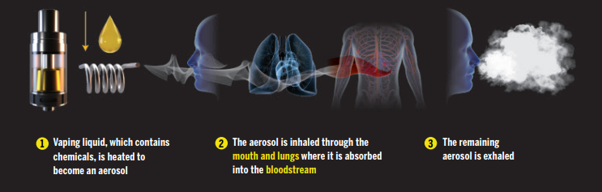
WHAT IS A VAPE AND HOW DOES IT WORK?
Notes:
Vaping is inhaling and exhaling vapourized liquid. Vaping doesn't require burning like cigarette smoking. The device heats a liquid into an aerosol (a fine mist) which is inhaled through the mouth and lungs, where it is absorbed in the bloodstream. The remaining aerosol is exhaled.

Slide 5

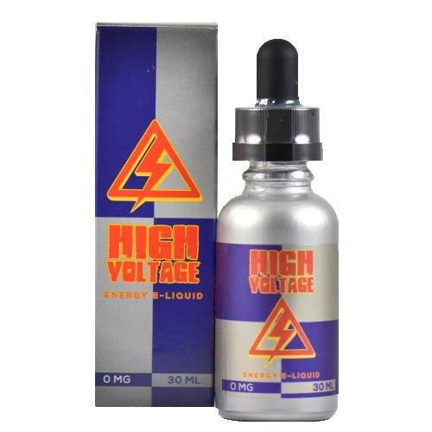

E-JUICE: IS IT JUST WATER?
All e-juices are different
Unregulated until 2020
When heated– chemical reaction changes the compounds
Notes:
E-juice is the liquid used to vape which contains nicotine, flavouring ingredients, chemicals (propylene glycol and/or glycerol-vegetable glycerin), metals and particles. Flavouring ingredients include chemicals and blends of chemicals used to make different flavours.

Slide 6

IS IT JUST WATER VAPOUR?
Notes:
Click on the video https://www.youtube.com/watch?v=MfQ6pKVkkl4

Slide 7
HARMFUL CHEMICALS FOUND IN VAPES
Formaldehyde- preservative found in labs and funeral homes
Acetone- nail polish remover
Benzene- found in detergents, insecticides and fuel
Notes:
The number of chemical ingredients used in vaping liquids varies. Formaldehyde, acetone and benzene have all been detected in vapes.
Additional Information
Between 2017-2019, researchers at Health Canada detected an average of 22 chemicals and roughly nine flavouring chemicals in Canadian vaping products. Additional chemicals can also form when vaping liquids are heated (through the aerosolization process) or if liquids come into contact with parts of the vaping device (e.g., coil).
The following is a list of some harmful chemicals found in vapes (Lung.org):
Propylene glycol – a common additive in food; also used to make things like antifreeze, paint solvent, and artificial smoke in fog machines
Carcinogens- chemicals known to cause cancer, including acetaldehyde and formaldehyde
Acrolein – an herbicide primarily used to kill weeds, can cause irreversible lung damage
Diacetyl – a chemical linked to a lung disease called bronchiolitis obliterans aka "popcorn lung"
Diethylene glycol – a toxic chemical used in antifreeze that is linked to lung disease
Heavy metals such as nickel, tin, lead
Cadmium – a toxic metal found in traditional cigarettes that causes breathing problems and disease
Benzene – a volatile organic compound (VOC) found in car exhaust
Ultrafine particles that can be inhaled deep into the lungs

Slide 8

QUESTION?
What do you think makes vaping so addictive?
Notes:
Ask: What do you think makes vaping so addictive?
Nicotine – a highly addictive substance that is found in tobacco cigarettes and vapes! It negatively affects adolescent brain development.

Slide 9

NICOTINE-IT’S ADDICTIVE
Reaches the brain in 7 seconds
Affects the front of the brain
Impulse control
Attention
Memory
Cognitive flexibility (think and learn)
Notes:
Nicotine is a highly addictive chemical found in tobacco plants, and most vape liquids. It reaches the brain in 7 seconds
Nicotine affects the front of the brain- as the brain is developing until age 25. Nicotine can affect impulse control, attention, memory and ability to think, and learn.
Vaping with nicotine can cause physical dependence and/or addiction among users who have not used nicotine before. (e.g. do not already smoke). This means that vaping may be VERY hard to stop once you start.

Slide 10

ACTIVITY
Nicotine is nicotine - Health Canada Experiences
Notes:
Click on link for activity

Slide 11


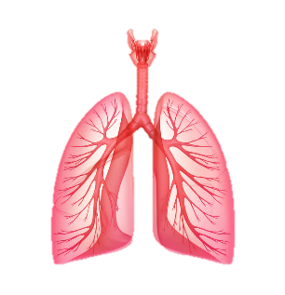

HEALTH EFFECTS OF VAPING
IMMEDIATE
OVER TIME
Effects on Body
Coughing, wheezing
Shortness of breath
Inflammation of the lungs
Increased heart rate and blood pressure
Ear, eye, and throat irritation
Physical Health Issues
Heart disease
Possible lung damage
Long-term effect still unknown due to the short time vapes have been on the market.
Effects on Brain
Difficulty focusing
Anxiety, fear, or panic
Addiction to nicotine
Notes:
Let’s talk about what happens to your body when you vape:
Based on current information, we know there are health risks when people use these products.
(Click) The aerosols produced by the chemicals in e-juice, enter the user’s lungs and can leave cancer causing chemical residue behind,. There have been studies of severe asthma exacerbation (flare up) due to vaping as well as difficulty breathing. Short-term effects within the respiratory system may include coughing/wheezing and swelling of the lungs.
(Click) Also, many e-cigarettes/vapes contain nicotine, which is known to have effects on the cardiovascular system, and lead to heart disease. Nicotine can increase the heart rate and blood pressure.
(Click) Ear, eye and throat irritation is common among e-cigarette/vape pen users. The fine particles and chemicals that are inhaled into the lungs can aggravate existing lung conditions making it harder to breath. The chemicals on their own have health impacts, but researchers are also finding that they have different effects when heated and when they combine in the body.
And perhaps most worrisome is the possibility of more young people developing an addiction to nicotine.
(Click) Nicotine use in early adolescence causes changes in the brain that make addiction much more likely for young e-cigarettes/vape pens users.
This is only the beginning of revealing the health risks associated with long-term e-cigarette use.
Decades of research to know the harmful effects of smoking…we don’t know the long-term effects of vaping yet.

Slide 12
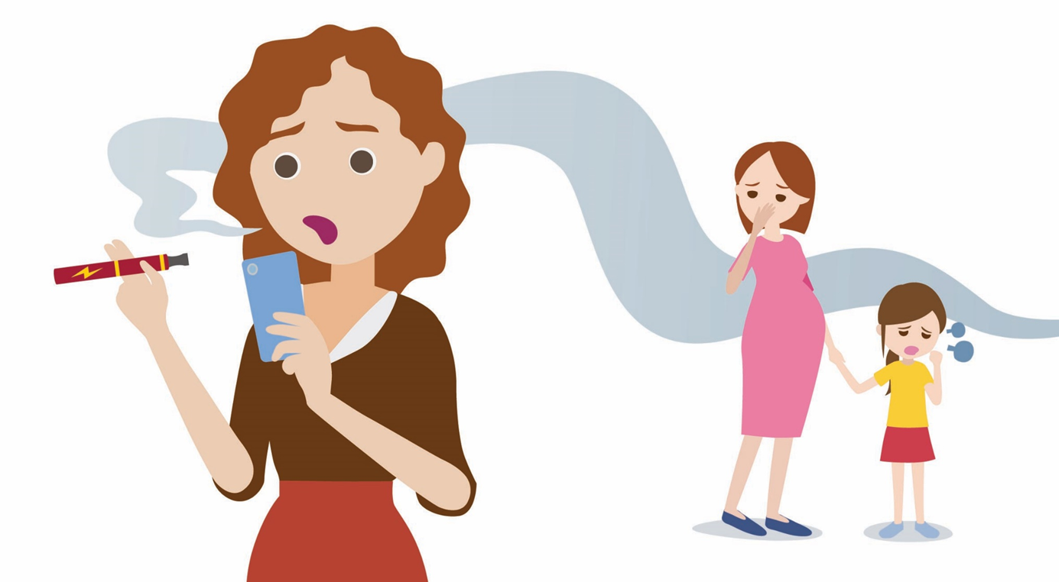
SECOND & THIRD HAND EXPOSURE
Notes:
Second hand exposure to vaping comes from the heating of e-juice and from when the aerosol is exhaled. Third hand exposure occurs when the aerosol leaves nicotine and other chemicals on indoor surfaces, skin, fur and furniture, even after the air has cleared.
The health effects from exposure to second and third hand aerosol from vaping are still being studied.

Slide 13

WHAT IS PEER PRESSURE?
Being influenced by someone or something
Choosing to do something you would not otherwise do, in hope of feeling accepted or valued by others
Notes:
Click on picture to start video https://www.youtube.com/watch?v=a6_8zBcm7xk-
Peer pressure is about being influenced and choosing to do something you would not otherwise do, in the hope of feeling accepted and valued by others. Peer pressure can be spoken or unspoken, direct or indirect and healthy and unhealthy. Students will experience peer pressure in one way or another. Peer pressure and influence might result in students:
• choosing the same clothes, hairstyle, or jewellery as their friends.
• listening to the same music or watching the same TV shows as their friends.
• changing the way they talk or the words they use.
• doing risky things or breaking rules.
• working harder at school or not working as hard.
• dating or taking part in sexual activities.
• vaping, using alcohol, or other drugs.

Slide 14
WHAT IS A GOOD FRIEND?
•Accepting
•Does not pressure you into doing something you do not want to do
• Positive peer influence
• Does not use drugs and can keep you from using drugs
• Wants to help you
Notes:
Ask: What is a good friend?
A good friend is:
• Someone who accepts you as you are, accepts your decisions, and watches out for you.
• Someone who does not pressure you into doing something you do not want to do.
• Is a positive peer influence
• Someone who does not use drugs and can keep you from using drugs.
• Someone who wants to help you, and recommends people or community resources that can provide support when dealing with choices or situations involving substance use and addictive
behaviours.

Slide 15

HOW DO I SAY NO!
Notes:
You may find yourself in situations that you may not be comfortable with or were unexpected. Practicing now what you may say later will help you feel more prepared.
There are many different refusal techniques or ways to say no. Some techniques will work well for some, while others will need a different approach. It’s important for you to practice the technique that works best for you before you’re in the situation.

Slide 16

WAYS TO SAY NO!
Say “NO THANKS”
Give a reason, fact, or excuse
Use humor, laugh it off
Change the subject or suggest an alternative
Walk away
Broken record or repeated refusal
Cold shoulder or ignoring
Avoid the situation
Have an escape plan
Strength in numbers
Notes:
Say “NO THANKS”
• Say no politely BUT use a strong and assertive tone of voice.
• Ask the person offering substances to quit offering.
• Do NOT feel guilty for saying no and Do NOT look away.
• Look at them in the eyes, be firm and appear confident.
• The more determined you are the less likely someone will try to challenge you
Give a Reason, Fact, or Excuse
The excuse needs to get you away from the person or situation. Practice an excuse so that you won’t hesitate and will sound confident. Blame someone lese such as parents to get out of the situation. Here are some examples:
• “My mom just called; sorry I have to go something happened at home.”
• “My parents would ground me for life.”
Use Humour, Laugh it OFF
Humour is a great way to alleviate stress. When offered to do or try something you don’t want find a joke that can help excuse you from the situation. Here are some examples:
• “No thanks, this stuff stunts my growth. I want to be tall to play ball.”
• “Man, I need all the brain cells I can get. No thanks.”
Change the Subject or Suggest an Alternative
When possible, try to change the focus and offer an alternative activity such as:
• “We could go and get something to eat instead.”
• “No. Let’s go and play ball instead.”
Walk Away
One of the most effective refusal skills is to walk away. Even though you may feel obligated to stand and face “the enemy” you need to just walk away while saying NO. Leaving the situation sends a powerful message to those who try to push you into something you do not want to do or try. For some people it does not make a difference the amount of explaining or excuses you make, they just do not understand your situation. Therefore, you are better off just removing yourself from this situation.
Broken Record or Repeated Refusal
Keep saying “NO” over and over again. It may buy you some time to use another refusal skill or the other person might get annoyed.
Cold Shoulder or Ignoring
Avoid directly confronting the person. Turn your shoulder and talk to someone else or just ignore them like you don’t hear them.
Avoid the Situation
Common sense tells you the places and times where there may be problems with peer pressure. Avoid these situations when you can.
Have an Escape Plan
Having an escape plan is perhaps the single best second option when attending a social event. An escape plan allows young people to try new things and attend places that might not be comfortable, but also gives them the security that there is a way out if things get too heavy. Before attending the event, coordinate with a friend or family member that you will be there for you. You can arrange the following beforehand:
• Safety agreement: consider discussing with your parents (or another trusted adult/friend) a plan to have them pick you up if you do not have a safe ride home. Part of this agreement
may that your parents/trusted adult agrees to not ask any questions about what happened or delay asking any questions until the next day.
• Texting a code word: this is another type of agreement you may discuss with your parents, trusted adult or friend. If you are stuck in a situation and need to get out of it you could text “X”, or another code of your choice, to your parents, a trusted adult, or a friend.
Strength in Numbers
Bring a friend-It is easier to say no as a group. You and you friend can watch each other back. If you surround yourself with friends that make good choices, then you will too.

Slide 17

ACTIVITY
Notes:
Refusal Skill Matching Activity
Activity Instructions:
Display the previous slide for the students to see.
Read the following examples of refusals. Have the students decide which skill is being used.
1. No thanks, I’m good I don’t want to- Say “NO THANKS”
2. Ψου κεεπ σαψινγ ΝΟ οϖερ ανδ οϖερ αγαιν− Βροκεν Ρεχορδ
3. Χομμον Σενσε τελλσ ψου τηε πλαχεσ ανδ τιμεσ ωηερε τηερε μαψ βε προβλεμσ ωιτη πεερ πρεσσυρε, σο ψου χαν αϖοιδ τηε σιτυατιον− Αϖοιδ τηε σιτυατιον
4. Ψου βρινγ α φριενδ ωιτη ψου τηατ ωιλλ αλσο ρεφυσε ιφ πεερ πρεσσυρε αρισεσ− Στρενγτη ιν νυμβερσ
5. Ι’μ ΟΚ ανδ ωαλκ αωαψ− Ωαλκ αωαψ
6. Ι φοργοτ Ι ηαϖε α δοχτορ∋σ απποιντμεντ τηισ αφτερνοον− Γιϖε α ρεασον
7. Μαν, Ι νεεδ αλλ τηε βραιν χελλσ Ι χαν γετ. Νο τηανκσ− Υσε ηυμορ
8. Διδ ψου φινιση ψουρ ηομεωορκ φορ τομορροω?− Χηανγε τηε συβϕεχτ
9. Πιχκ α σαφε ωορδ ανδ εσταβλιση γρουνδ ρυλεσ. “Μομ, ιφ Ι σενδ ψου αν αστερισκ (∗), τηατ μεανσ χομε ανδ γετ με ΑΣΑΠ”− Ηαϖε αν εσχαπε πλαν
10. Τυρν ψουρ σηουλδερ ανδ ταλκ το σομεονε ελσε ορ ϕυστ ιγνορε τηεμ λικε ψου δον’τ ηεαρ τηεμ− Ιγνορε
OR use any activity from the Refusal Skills and Scenarios : https://www.wechu.org/substance-use/refusal-skills-classroom-activities

Slide 18

VAPING REGULATIONS
Vaping is NOT allowed on school property and within 20m from the perimeter of the school – 2 bus lengths
Cities/towns have bylaws in place restricting vaping areas such as parks, playgrounds, and sport fields
Supplying youth under 19 years (giving a tobacco product, a vape, or any vape component- including e-juice) is illegal
Notes:
As of October 2018, the use of vaping is prohibited anywhere smoking is not allowed. Plus, additional restrictions (20m from school property, rec facilities, playgrounds, 9m from patios, etc.) 24 hours a day, 7 days a week. This means a person must be 2 school bus lengths away from the edge of school property before smoking or vaping. Breaking the law could result in a fine of $305.
In Ontario:
As of January 1, 2016, it is illegal to sell or supply vapes and component parts (e.g., liquid, battery, atomizer) to anyone under 19. This includes underage friends sharing products or parents giving products to their kids. Breaking this law could result in a fine of $490.

Slide 19

WHERE TO GET HELP?
Child and Youth Worker/MAHN
An adult you trust
Public Health Nurse
Your health care provider
Other supports: Kids Help Phone
Quash App

Slide 20
KEY MESSAGES
Long term health effects are unknown
Ingredients in e-juice are harmful
Nicotine = addiction
If you don’t smoke, don’t vape
Just say NO!
Notes:
Key messages include:
Long term health effects from vaping are unknown.
Ingredients in e-juice are harmful.
Nicotine is addictive.
If you don’t smoke, don’t vape.
Practice saying “No”.

Slide 21


Slide 22
REFERENCES
Canadian Cancer Society. (2019). Study finds dramatic 74% increase in youth vaping in Canada. Available: https://www.cancer.ca/en/about-us/for-media/media-releases/national/2019/youth-vaping/?region=on
Hammond, D., Reid, J.L., Rynard, V., L., Fong, G.T., Cummings, K.M., McNeill, A., … & O’Connor, R. (2019) Prevalence of vaping and smoking among adolescents in Canada, England, and the United States: repeat national cross sectional surveys. bmj, 365, I2219.
Health Canada. (2019). Risk of Vaping. Retrieved from https://www.canada.ca/en/health-canada/services/smoking-tobacco/vaping/risks.html
Hess, CA., Olmedo, P., Navas-Acien, A., Goessier, W., Cohen , JE., & Rule, AM. E-cigarettes as a source of toxic and potentially carcinogenic metals. Environmental Research, 2017; 152:221 DOI:10.1016/j.envres.2016.09.026
John Hopkins Bloomberg School of Public Health. (2017). Study: Toxic metals found in e-cigarette liquids. Retrieved from https://www.jhsph.edu/news/news-releases/2017/study-toxic-metals-found-in-e-cigarette-liquids.html
Ontario Agency for Health Protection and Promotion (Public Health Ontario), Berenbaum E, KellerOlaman S, Manson H, Moloughney B, Muir S, Simms C, Singh H, Watson K. Current evidence on ecigarettes: a summary of potential impacts. Toronto, ON: Queen’s Printer for Ontario; 2018.
Adapted from Niagara Public Health

